Slide 1



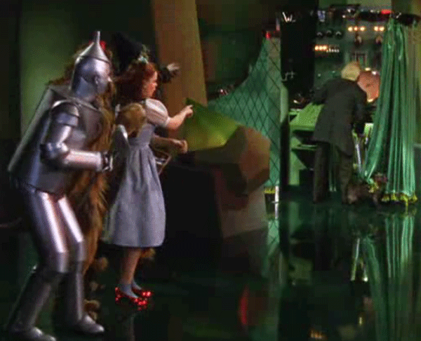
Administrative Law: Greatest Hits
(exhausting, perhaps, but not exhaustive)
Markus Dubber
Spring 2012

Slide 2

Déjà vu…Introduction and focus
Introduction
  General approach
  What is administrative law?
  Where does it come from?
  Conceptual frameworks/
  themes
Focus
  Crime victim compensation
  Administration/administrative law in action

Slide 3
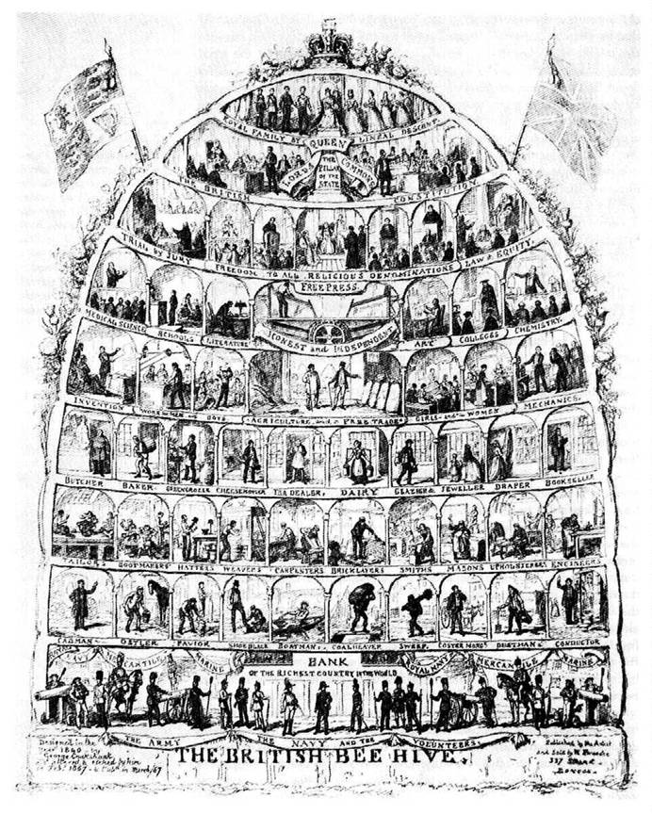
General approach
Non-constitutional constitutional law
  Structure of government; individual vs. state
  (common law “fairness”; rule of law)
  Everyday/soft constitutional law
Public law (vs. private law)
  State-state; state-person vs. person-person
Modern (administrative/regulatory) state
  Discretion, discretion, discretion
  Agencies, commissions, tribunals, boards,
  departments …
Statutes/statutory interpretation
  vs. common law (judiciary)
  enabling statutes vs. directive statutes (e.g., criminal law)
The State! (vs. government)
  State functions (officials)/branches of government
  Interrelation, deference, coordination, control, supremacy
Significance of executive (vs. judiciary, legislature)
  administration matters

Slide 4
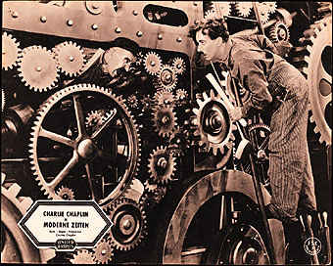
General approach cont’d
General principles, not doctrinal details
  vs. environmental law, tax law, immigration law, labor law/workers’ compensation, securities law/regulation, public utilities, health (assistance, control), professions/trades/licensing, prison law, human rights
  General part of administrative law
  Special part (focus)
    victim compensation law
    vs. private law (torts), other public law (criminal)
Historical vs. analytical
  Mix: procedural/substantive review, chronological within
Conceptual vs. doctrinal
  Rule of law, natural justice, procedural fairness

Slide 5
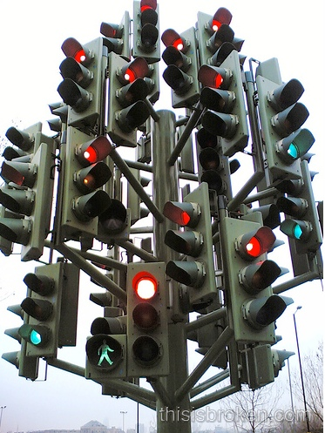
What is administrative law?
The administration of law, the law of administration, administration and (vs.?) law
Administration
  Government, executive, regulation
    What government does/how
    government does
Law
  Positive (green-light)
    What government does
  Negative (red-light)
    What government may
Internal/External
  Review
    Government in miniature (Willis)
  Good/Efficient vs. Right/Just

Slide 6
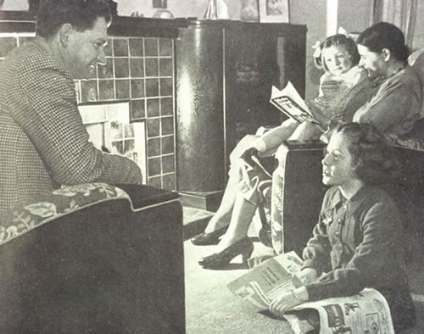

Where does it come from?
The Act of Government
  Family/Household
  Great Family of the State
Rationalization: Police Science & Police Power
  Economy/Political Economy
Expansion and diversification of police power
  The Modern/Welfare/Regulatory State…
Administrative Law
  Disappearance/minimalization of
  police
    Police as security/institution

Slide 7

Conceptual frameworks/themes
Administrative law vs. administration
Administrative law vs. regulation
Law vs. police
Public vs. private law
Managerial direction vs. law (Fuller)
Rule of law vs. rule of men (experts, bureaucrats, civil servants)
Three Approaches (Willis)
Goldilocks (too hot vs. too cold
vs. just right)

Slide 8

Law vs. Police
Ideal types, modes, approaches, frameworks
  analysis, critique
Conduct vs. status
  conduct vs. character
  of governor and governed
Person vs. (human) resource
  power to “govern men and things”
Defense vs. exemption
Rule vs. standard
Norm vs. measure
  Norm vs. prerogative
Formal vs. informal
Principles/rules vs. guidelines/maxims
Rigid vs. flexible
Constraint vs. discretion
Justice vs. efficiency/welfare
Right vs. good
Legitimacy vs. prudence
Rights vs. interests
Private vs. public
  Public vs. private
Autonomy vs. heteronomy
Government vs. management
Person vs. resource
Equality vs. hierarchy
Judiciary vs. executive
Legislature vs. executive
Fiction vs. fact
  Ideology vs. reality
  Ideal vs. actual
  Theory vs. practice

Slide 9
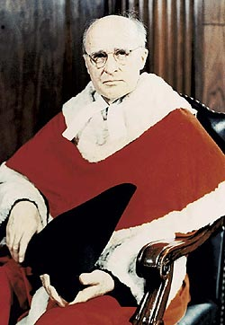
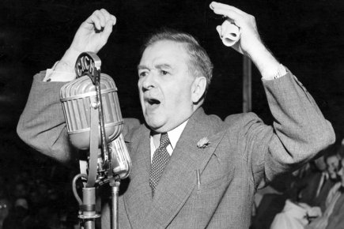
Roncarelli 1959:
Rule of Law Rule
The act of the respondent through the instrumentality of the Commission … was a gross abuse of legal power …. That, in the presence of expanding administrative regulation of economic activities, such a step and its consequences are to be suffered by the victim without recourse or remedy, that an administration according to law is to be superseded by action dictated by and according to the arbitrary likes, dislikes and irrelevant purposes of public officers acting beyond their duty, would signalize the beginning of disintegration of the rule of law as a fundamental postulate of our constitutional structure. [A]t this stage of developing government it would be a danger of high consequence to tolerate such a departure from good faith in executing the legislative purpose. (R44)

Slide 10
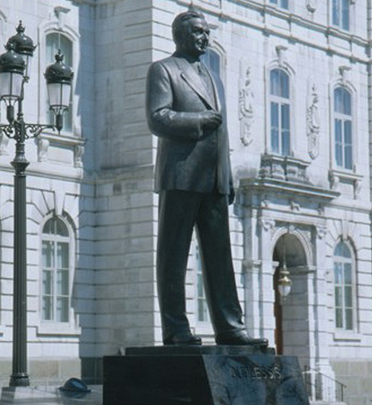
Rule of Law Complexification
Rules of Law vs. Rule of Law vs. Rule of Laws
  Public law vs. private law (personal liability)
    Immunity (Dicey)
  Procedure vs. substance
    Art. 88 Quebec Civil Code:
    No public officer or other person fulfilling any public function or duty can be sued for damages by reason of any act done by him in the exercise of his functions … unless notice of such action has been given him at least one month before the issue of the writ of summons.
  Procedure over substance?
    Less intrusive
  Substance over procedure?
    Who cares about process? Merits matter!

Slide 11
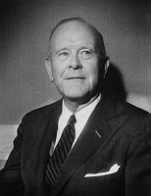
Rule of Law vs. “Rule of Law”
Horwitz
  Douglas Hay: the "rule of law" as an ideology required the English ruling classes to accept a degree of self-limitation in order to govern effectively. [U]se of legal ideology as a means of social control required that it be believed and acted upon by both higher and lower classes.
  E.P. Thompson: [T]here is a difference between arbitrary power and the rule of law. We ought to expose the shams and inequities which may be concealed beneath this law. But the rule of law itself, the imposing of effective inhibitions upon power and the defence of the citizen from power's all-intrusive claims, seems to me to be an unqualified human good. To deny or belittle this good is, in this dangerous century when the resources and pretensions of power continue to enlarge, a desperate error of intellectual abstraction.
Altman (Critical Legal Studies)
  Law vs. politics/morals; “correct” legal solution (Llewellyn); judges impose political and moral views under cover of law
  Indeterminate legal rules don’t determine cases; political/moral views do
  Law rule fetishism
Fuller: Managerial direction vs. rule of law
  Rules
  Publicity
  Prospectivity
  Understandability
  Consistency
  Possibility
  Constancy
  [Congruence]

Slide 12

Ocean Port 2001
independence (liquor board appointment “at pleasure”)? Procedural fairness/natural justice?
Decision:
  Not for us to decide: plumb and implement legislative intent
  “The appellant, with the support of the intervening Attorneys General, argues that this reasoning disregards a fundamental principle of law: absent a constitutional challenge, a statutory regime prevails over common law principles of natural justice.
  … It is the legislature or Parliament that determines the degree of independence required of tribunal members. The statute must be construed as a whole to determine the degree of independence the legislature intended.”
  Principles of natural justice as guidelines of statutory interpretation (rebuttable presumption)
    “like all principles of natural justice, the degree of independence required of tribunal members may be ousted by express statutory language or necessary implication” (22)
      As in this case: “at pleasure”
    Only applicable to “silent or ambiguous legislation”: “Confronted with silent or ambiguous legislation, courts generally infer that Parliament or the legislature intended the tribunal's process to comport with principles of natural justice.” (not constraint, only guide

Slide 13

Willis on Statutory Interpretation
(1) Ordinary Meaning: ”What is the meaning of this word when read alone?”
  Dictionaries (statutory, law, general)
(2) Context 1: ”What is the meaning of this word when read together with the rest of the words of the Act?”
  “Words, like people, take their colour from their surroundings.”
  (a) “Noscitur a sociis” [known by his/her associates]
    general word takes its colour from the preceding specific words with which it is used [in “stab, cut or wound,” “wound” does not include biting off nose…]
(b) “Ejusdem generis” [of the same kind]
    general phrase ("or other causes", "and all kinds of merchandise”; "an automobile, automobile truck, automobile wagon, motorcycle, or any other self-propelled vehicle not designed for running on rails” doesn’t include airplane)
(c) “Expressio unius [est] exclusio alterius” [the expression of one [is] the exclusion of another]
(3) Subject matter (context 2): ”What is the meaning of this word when read against the background of that part of human conduct with which the Act is dealing?”
  Sum: “A court invokes whichever of the rules produces a result that satisfies its sense of justice in the case before it.”

Slide 14
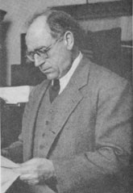
Llewellyn’s Three Ingredients of Statutory Interpretation
Friends call me Löwelein
Current tradition
  Grand Style (principle over precedent)
  Formal Style (precedent over principle)
Current temper
  Love of creativeness
  Love of order
Situation sense
  Accidental sympathy vs. long-range justice for all

Slide 15
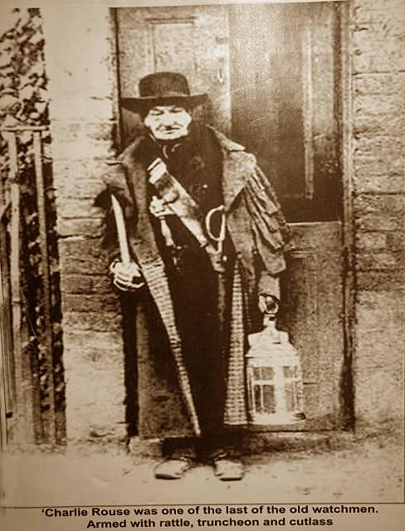
Nicholson v. Haldimand-Norfolk 1979
(1) No reasons, (2) no notice, (3) no hearing
Duty of (procedural) fairness? yes, sort of (natural justice with
a small “n” (and a small “j”…)) [halfway house…]
Rand-talk:
  The effect of the judgment below is that a constable who has served eighteen months or more is afforded protection against arbitrary discipline or discharge through the requirement of notice and hearing and appellate review, but there is no protection at all, no halfway house, between the observance of natural justice aforesaid and arbitrary removal in the case of a constable who has held office for less than eighteen months.
The Halfway House (lower-case natural justice, natural justice lite, mini-NJ…): what, precisely, is Nicholson (public officeholder) owed?
  Depends… (fair, not arbitrary…); Goldilock-y: just right
  “If there were too much elaboration of procedural safeguards, nothing could be done simply and quickly and cheaply. Administrative or executive efficiency and economy should not be too readily sacrificed.”
  Classification? quasi-judicial (22)
    Conceptual vs. functional (Mullan…) (23)
    Can’t tell quasi-judicial from judicial from administrative

Slide 16

Baker 1999
The Fabulous Baker Factors
nature of the decision being made and the process followed in making it
  The more (judicial), the more (part. rights)
nature of the statutory scheme and the "terms of the statute pursuant to which the body operates”
  E.g., no appeal
the importance of the decision to the individual or individuals affected
legitimate expectations of the person challenging the decision
  Can’t break promises re: process,
  or re: outcome w/o due process
agency’s choice of procedures
list not exhaustive etc. etc. etc. …

Slide 17
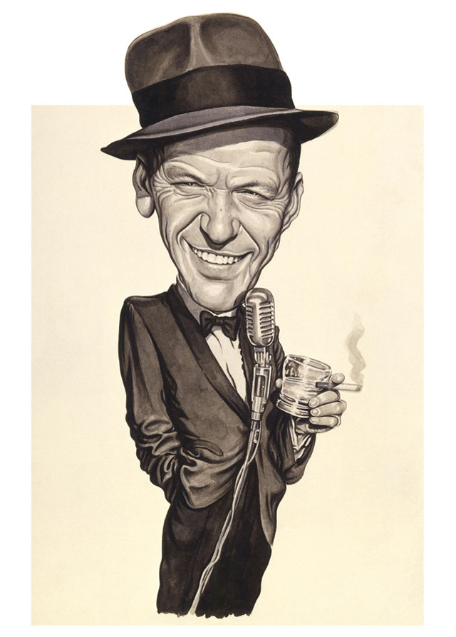
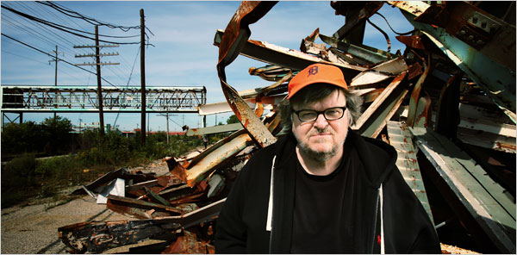
Consolidated Bathurst 1990
Full board (“the impugned meeting”): what Chairman Adams said
  “There is no evidence that the particular meeting impugned in this case was used to impose any given opinion upon the members of the panel, or that the spirit of discussion and exchange sought through those meetings was not present during those deliberations.”

Slide 18

Analysis
Two rules of natural justice
  (1) Nemo iudex in causa sua
    Independence of panel members
  (2) Audi alteram partem
Context: “institutional constraints”
  Efficiency coin of the realm: “tribunals created to increase the efficiency of the administration of justice”
    full board meeting vs. full board hearing
    Accumulation of experience; coherence
  Full board: good enough for gov’t work
    “Like many other judicial practices … full Board meetings entail some imperfections …”

Slide 19

Newfoundland Telephone 1992
Bias in administrative law
  Flexible/adaptable
    Functional spectrum:
purely adjudicative quasi-land political
law-applying hybrid-town policy-making
judicial legislative
“judicial impartiality” somewhere in between “open mind”
“no reasonable apprehension” halfway-house? [= a “not completely
Goldilocks? closed mind”!]
- in fact, not in belief
- commercial arbitrators ??????? - municipal councillors
- Nat’l Energy Board (pipeline bids; (city planning; political
“public interest”) actors; elected to represent particular interests)
- public utilities commissioners! (no “bland civil servants” wanted!)

Slide 20
Which standard? Which version of the standard?
Reasonable apprehension of bias, or shades of red
Court at trial board acting solely in gov’t in adjudicative capacity miniature
“strict and rigid” Goldilocks “not as strict and rigid”

Slide 21

CUPE ‘79 (Nicholson’s substantive classmate)
Dickson: but first, a preliminary matter…
With respect, I do not think that the language of "preliminary or collateral matter" assists in the inquiry into the Board's jurisdiction. One can, I suppose, in most circumstances subdivide the matter before an administrative tribunal into a series of tasks or questions and, without too much difficulty, characterize one of those questions as a "preliminary or collateral matter". [Q]uestions of fact will naturally be regarded as "the primary and central questions for decision", whereas the "prescribed statutory ingredients will be more readily found to be collateral".
The question of what is and is not jurisdictional is often very difficult to determine. The courts, in my view, should not be alert to brand as jurisdictional, and therefore subject to broader curial review, that which may be doubtfully so.

Slide 22

Patent unreasonableness!?
In my view, that would be sufficient to dispose of this appeal. The Court of Appeal wrongly was of the opinion that the existence of the prohibition was a preliminary matter and, therefore, the Board's decision was subject to review for its "correctness." I would take the position that the Board decided a matter which was plainly confided to it, for it alone to decide within its jurisdiction.
It is contended, however, that the interpretation placed upon s. 102(3)(a) was so patently unreasonable that the Board, although possessing "jurisdiction in the narrow sense of authority to enter upon an inquiry", in the course of that inquiry did "something which takes the exercise of its powers outside the protection of the privative or preclusive clause".
  Was the Board's interpretation so patently unreasonable that its construction cannot be rationally supported by the relevant legislation and demands intervention by the court upon review?
    No…

Slide 23
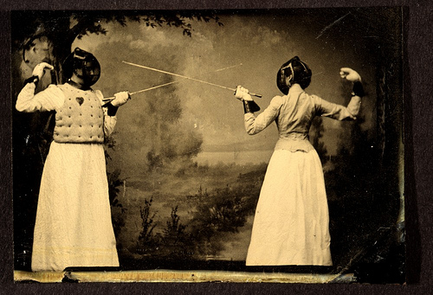

Mossop 1993:
Let the Substance Begin, or Has It Already?…
Some useful (…) distinctions in administrative law
Substance vs. process
  the substance of process
    rule of law vs. rule of process vs. rule by judges
    Does process matter?
    Does substance matter?
  the trouble with substance
    Roncarelli; legitimacy
Law vs. mixed fact/law vs. fact
  Rule vs. application
    Scope/flexibility of norm (rule vs. standard)
  Relevance? (standard of review; deference)
Jurisdiction vs. non-jurisdiction
  merits vs. scope (beyond the pale)
  Intent (R-E-S-P-E-C-T) (vs. legislature/admin trib)
Judicial vs. administrative (executive, ministerial) vs. legislative
  Nicholson

Slide 24
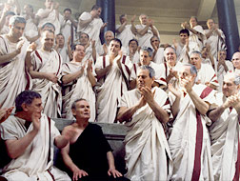
La Forest
The Standard
Deference re: questions of fact
  Patent unreasonableness
No deference re: questions of law
  Correctness
BUT Exceptions (e.g., labour board)
  Strong privative clause (cf. Consolidated Bathurst)
    Not here
  Expertise
    Not here
      Adjudicative
        Not even labour arbitrator (never mind board)
          Not self-selected (relevance?)
          “direct influence on society at large in relation to basic social values” (?)
      Expertise re: fact-finding and adjudication only

Slide 25

La Forest
The Standard Applied
“Family status”
  Statutory interpretation ABC (that’s what we, courts, do best!):
    In determining the intent of Parliament, one must, of course, give to the words used in a statute their usual and ordinary sense having regard to their context and to the purpose of the statute.
      Of course!
    “The dominant conception of family is the traditional family.” …
      Statutory language, extraneous evidence (re intent) clear
      Nothing to interpret: easy as pie
        How could Tribunal get so much so wrong?!
        Luckily, the courts are there to fulfill their “general supervisory role”!

Slide 26
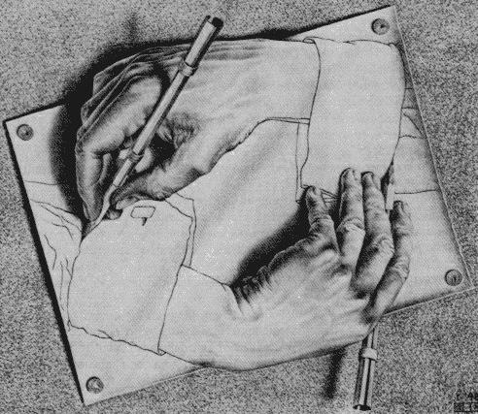
L'Heureux-Dubé (dissent)
Patent unreasonableness
  1. Statute
    Human Rights Act
      Broad powers
      No privative clause (nor the opposite (enabling?)…)
  2. Board
    “highly specialized admin body”: sensitivity, understanding, and expertise (Baker?)
      Experience; commission complaint (see arguments in Mossop)
  3. Problem
    “context-specific setting”
  Exhaustive list? No…
What difference does it make?
  Would L'Heureux-Dubé have reached a different result
    under a different standard of review (correctness, say)? [see Cory and McLachlin dissents!]
    under the same standard, or any standard, if the Tribunal had ruled the other way?
  Would La Forest have reached a different result under the patent unreasonableness standard?

Slide 27

Dunsmuir 2008
Standards of review: a brief history
  Formalism: Jurisdiction (The Dark Ages)
    Preliminary question doctrine
      Did the agency act within its jurisdiction?
        If so, deference (intra vires)
        If not, ultra vires!!!: no deference
  End the hypocrisy: Pragmatic and
  functional (The Enlightenment)
    Two standards of review (Enlightenment I)
      Correctness
      Patent unreasonableness (CUPE 1979)
  Southam (1997) (Iacobucci) (Yet more light: Enlightenment II)
    More nuance, more pragmatism/functionalism:
      We need a third standard of review:
        Reasonableness simpliciter (just plain ole reasonable, reasonable, period, reasonable, no ice, reasonable straight up etc)

Slide 28

“History” cont’d
Confusion! Critique!
  What’s the difference (lower courts)?
  Degrees of irrationality (Mullan)?
Dunsmuir (2008): The Advent of Holism, The Irrelevance of Labels!
  From “pragmatic and functional” to holistic approach; from “pragmatic and functional analysis” to “standard of review analysis”
  Two are better than three, after all
    Henceforth, it shall be
      Reasonableness
      Correctness

Slide 29

Shell 1994 (Sopinka)
Reviewability of city council resolution (ultra vires?)
  Legislative vs. quasi-judicial vs. business/commercial
    Irrelevance for purposes of reviewability
      All actions, however classified, reviewable for jurisdiction--all power is delegated via statute (municipality “creature of statute”), which also defines the power’s scope—ultra vires
      “only remedy is at the polls” cold comfort for minority
    McLachlin agrees…but within limits…
Improper Purpose (ultra 1); unauthorized Discrimination (ultra 2)
  Yes: beyond power to “promote health, safety or welfare of the inhabitants of the City” (McLachlin: not so)

Slide 30

Baker Take 2 (1999): substance
Pushpanathan factors: same old, same old
Application
  Reasonableness simpliciter
  1. Privative clause (-)
    No
    Provision for appeal (tho’ limited to certified question)
  2. Expertise (+)
    Plenty (vis-à-vis courts): Minister (Lorenz?)
  3. Purpose (=)
    Choice; “open-textured” principles; “exemption,” not rule
    But: application to specific individual vs. interest balancing (adjudicative vs. legislative/policy-making)
  4. Nature of question
    More fact than law (+)
  Goldilocksian middle: not correctness, not patent unreasonableness—reasonableness simpliciter (+)

Slide 31
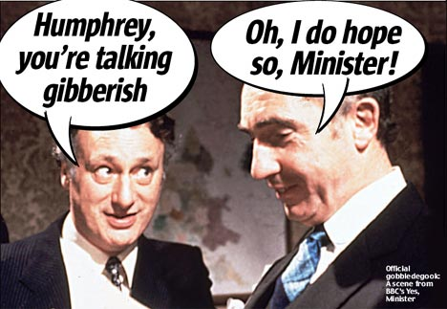
Suresh 2002
Standard of Review: Pushpanathan factors
  1. privative clause (=?)
    No private clause, but only limited appeal
    (by leave)
  2. expertise (+)
    Yes, Minister
      Special information and expertise…
  3. purpose of legislation (+)
    Balance interests (danger to Canada, to individual)
  4. nature of the question (+)
    Fact-based/contextual
Therefore: patent unreasonableness (+++)
  Baker was different: delegation + violation of self-imposed guidelines
No reweighing of factors; only appropriateness of factors (relevant, irrelevant)
  Baker didn’t weigh either

Slide 32

CUPE (2003): Binnie’s Roadmap
(1) the statutory interpretation of s. 6(5) of the HLDAA;
(2) procedural fairness issues:
  (a) the Minister's alleged lack of impartiality;
  (b) the Minister's alleged failure to consult with the unions about the change in the process of appointments;
  (c) the alleged violation of the doctrine of legitimate expectation in refusing to nominate only arbitrators who had been mutually agreed upon;
(3) an assessment of the standard of review of the Minister's appointments;
(4) when does a decision rise to the level of patent unreasonableness?
(5) whether the applicable standard of review was violated by the Minister's rejection of
  (a) the s. 49(10) list as a requisite of appointment, or
  (b) expertise and "broad acceptability within the labour relations community" as criteria for the selection of chairpersons
    all, and only, relevant factors

Slide 33
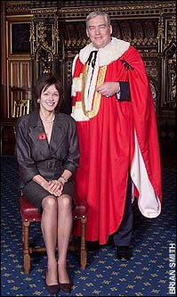
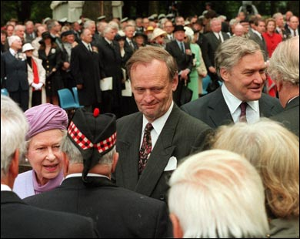

Slide 34
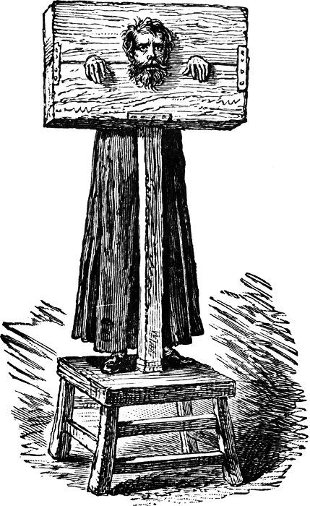


Thamotharem FCAppeal ’07:
Making Admin Law Softer Still!
Issues
  Procedural fairness? (correctness)
    No prob: plenty of fairness (inquisitorial = fair & fast)
  Discretion (self-)fettering? (correctness)
    No prob: soft law (nudge) only [Guideline 7]
  Rule vs. guideline (patent unreasonableness)
    No prob: discretion (flexibility)

Slide 35

CICB (not CIBC)!

Slide 36


