Slide 1
Administrative Law
Markus Dubber

Slide 2
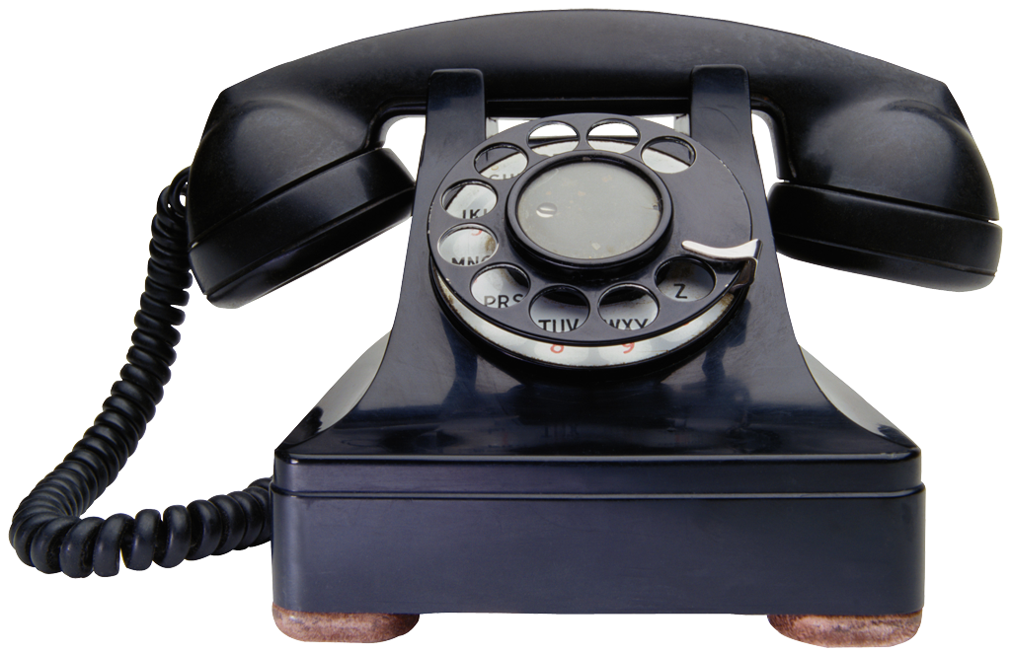


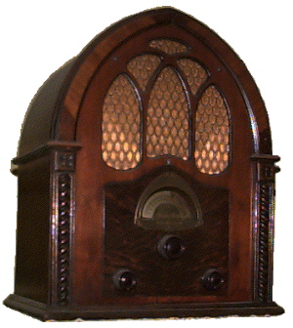
Newfoundland Telephone Co. v.
Newfoundland (Public Utilities Board)
3/92; Cory, J.
Timeline
Pre-85: Wells municipal councillor/consumers’ rights advocate
85: Wells appointed to board
Nov 10 ’88: hearing set for Dec 19
Nov 13: newspaper: ludicrous, unconscionable pay & benefits package
Nov 26: contempt for board (R-E-S-P-E-C-T!), “I'm not having anything to do with the salary increases and big fat pensions”
Dec 19: hearing; challenge; rejected for lack of jurisdiction
Jan 24 ‘89: continuation; TV
Jan 30: Evening Telegram
Apr 4: CBC Radio
Aug 3: board decision: refund pensions; nothing re: salaries; Wells concurs (“not an issue that has been finally resolved”…)

Slide 3
Bureaucrats, experts, representatives
The Composition and Function of Administrative Boards
Administrative boards play an increasingly important role in our society. They regulate many aspects of our life, from beginning to end.…In Canada, boards are a way of life. Boards and the functions they fulfil are legion….
The composition of boards can, and often should, reflect all aspects of society. Members may include the experts who give advice on the technical nature of the operations to be considered by the board, as well as representatives of government and of the community. There is no reason why advocates for the consumer or ultimate user of the regulated product should not, in appropriate circumstances, be members of boards. No doubt many boards will operate more effectively with representation from all segments of society who are interested in the operations of the board.

Slide 4
The Function in Function-al
Nor should there be undue concern that a board which draws its membership from a wide spectrum will act unfairly. It might be expected that a board member who holds directorships in leading corporations will espouse their viewpoint. Yet I am certain that although the corporate perspective will be put forward, such a member will strive to act fairly. Similarly, a consumer advocate who has spoken out on numerous occasions about practices which he, or she, considers unfair to the consumer will be expected to put forward the consumer point of view. Yet that same person will also (!) strive for fairness and a just result. Boards need not be limited solely to experts or to bureaucrats.
What is boards’ function? And what does representativeness have to do with it?
  Effectiveness, speed, efficiency, expertise
  Peace, fairness, justice, legitimacy
  Representativeness: internal vs. external
    Cf. Consolidated-Bathurst: employers’ and employees’ representatives
    Cf. legislature: representation/specific interests vs. justice/public interest
  Representativeness: intentional vs. actual
    board member vs. advocate

Slide 5



“all them fat cats with their big pensions”
Duty of fairness (Nicholson!, Baker!)
  Flexible/adaptable
    Cf. Baker factors
  Procedural fairness
    Participatory rights
    Bias
Bias
  Evidentiary difficulty (impossibility!)
    Therefore focus on apparent, not actual, bias
      Mens rea?
      All of sudden, proof questions all-important (cf. burden of proof confusion in Consolidated Bathurst)
    But: not subjective, but reasonable, perception/apprehension
      Test: “whether a reasonably informed bystander could reasonably perceive bias on the part of an adjudicator”

Slide 6
What, me biased?
Bias in administrative law
  Flexible/adaptable
    Functional spectrum:
purely adjudicative quasi-land political
law-applying hybrid-town policy-making
judicial legislative
“judicial impartiality” somewhere in between “open mind”
“no reasonable apprehension” halfway-house? [= a “not completely
Goldilocks? closed mind”!]
- in fact, not in belief
- commercial arbitrators ??????? - municipal councillors
- Nat’l Energy Board (pipeline bids; (city planning; political
“public interest”) actors; elected to represent particular interests)
- public utilities commissioners! (no “bland civil servants” wanted!)

Slide 7
The Law: The Public Utilities Act
14. The Board shall have the general supervision of all public utilities, and may make all necessary examinations and enquiries and keep itself informed as to the compliance by public utilities with the provisions of law and shall have the right to obtain from any public utility all information necessary to enable the Board to fulfil its duties.
79. Whenever the Board believes that any rate or charge is unreasonable or unjustly discriminatory, or that any reasonable service is not supplied, or that an investigation of any matter relating to any public utility should for any reason be made, it may, of its own motion, summarily investigate the same with or without notice.
83. The Board shall give the public utility and the complainant, if any, ten days' notice of the time and place when and where the hearing and investigation … will be held and such matters considered and determined and both the public utility and the complainant are entitled to be heard and to have process to enforce the attendance of witnesses.
85. If after making any summary investigation, the Board becomes satisfied that sufficient grounds exist to warrant a formal hearing being ordered as to the matters so investigated, it shall furnish such public utility interested a statement notifying the public utility of the matters under investigation and ten days after such notice has been given the Board may proceed to set a time and place for a hearing and an investigation as provided in this Act.

Slide 8
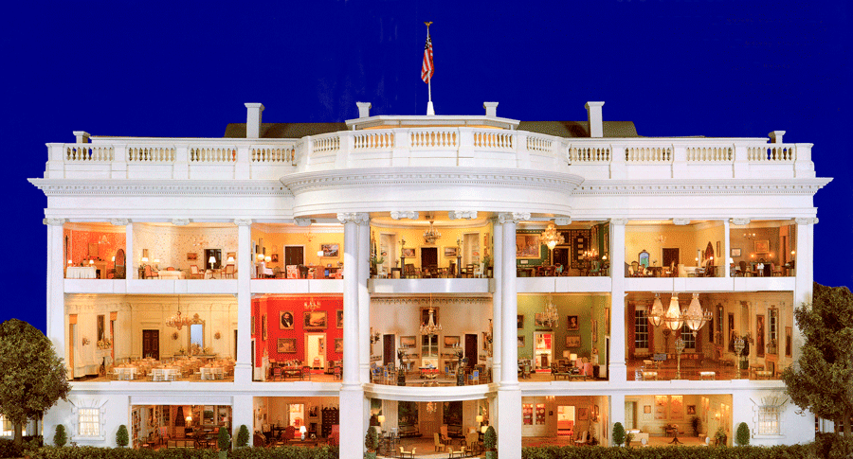
Government in Miniature
closed mind
reasonable apprehension of bias
Legislative: policy-making
  “unreasonable” or “unjustly discriminatory” rates
Executive: investigation
Judicial: adjudication
  Hearing
  When? Hearing date set (Nov. 10)
  The magic of Nov. 10: “Once the hearing date had been set, the parties were entitled to expect that the conduct of the commissioners would be such that it would not raise a reasonable apprehension of bias.“
  But standard doesn’t matter!: “not only was there a reasonable apprehension of bias but that Mr. Wells had demonstrated that he had a closed mind on the subject.”

Slide 9
Which standard? Which version of the standard?
Reasonable apprehension of bias, or shades of red
Court at trial board acting solely in gov’t in adjudicative capacity miniature
“strict and rigid” Goldilocks “not as strict and rigid”

Slide 10
Remedy
No harmless error
Procedural right “independent” and “unqualified”
  Incurable
Order void (contra Court of Appeal)
  not voidable (or not), depending on finding of actual, or merely perceived, bias and harm
  Reasonable perception of bias is violation by itself (regardless of accuracy or effect)

Slide 11
And Ocean Port (2001)?
Which standard? Which version?
Which stage/function (compliance vs. adjudication)? Which hearing (initial hearing vs. Liquor Appeal Board)?
The overlapping of investigative, prosecutorial and adjudicative functions in a single agency is frequently necessary for a tribunal to effectively perform its intended role: Newfoundland Telephone Co. v. Newfoundland (Board of Commissioners of Public Utilities), [1992] 1 S.C.R. 623 (S.C.C.) [!?]. Without deciding the issue, I would note that such flexibility may be appropriate in a licensing scheme involving purely economic interests.
Further, absent constitutional constraints, it is always open to the legislature to authorize an overlapping of functions that would otherwise contravene the rule against bias. …
As with most principles, there are exceptions. One exception to the "nemo judex" principle is where the overlap of functions which occurs has been authorized by statute, assuming the constitutionality of the statute is not in issue.
In some cases, the legislator will determine that it is desirable, in achieving the ends of the statute, to allow for an overlap of functions which in normal judicial proceedings would be kept separate. . . . If a certain degree of overlapping of functions is authorized by statute, then, to the extent that it is authorized, it will not generally be subject to the doctrine of "reasonable apprehension of bias" per se.
Thus, even assuming the plurality of functions performed by senior inspectors would otherwise offend the rule against bias, it may well be that this structure was authorized by the Act at the relevant time.

