Slide 1
Administrative Law
Markus Dubber

Slide 2

Consolidated Bathurst
Ontario Labour Relations Board (12/83)
Adams, Q.C. (later Justice, Ont. Superior Ct.)
Request to reconsider 9/83 decision
Lawyer/PI on the case…
  “At the house of 2:35 p.m., I observed an individual known to me as M.G. Mitchnick, Esq., …”
Claims
  Process (“improper and illegal practice”)
    Full board
    Also: expanded union’s complaint w/o opportunity to reply; Incorrect/incomplete findings

Slide 3
Labour Relations Board Act, 1944
Sec. 102 (2) The Board shall be composed of a chairman, one or more vice-chairmen and as many members equal in number representative of employers and employees respectively as the Lieutenant Governor in Council considers proper, all of whom shall be appointed by the Lieutenant Governor in Council.
(4) The chairman or, in the case of his absence from the office of the Board or his inability to act, the alternate chairman shall from time to time assign the members of the Board to its various divisions and may change any such assignment at any time.
(8) Each member of the Board shall, before entering upon his duties, take and subscribe before the Clerk of the Executive Council and file in his office an oath of office in the following form:
I do solemnly swear that I will faithfully, truly and impartially to the best of my judgment, skill and ability, execute and perform the office of chairman (or vice-chairman or member) of the Ontario Labour Relations Board and I will not, except in the discharge of my duties, disclose to any person any of the evidence or any other matter brought before the Board. So help me God.
(9) The chairman or a vice-chairman, one member representative of employers and one member representative of employees constitute a quorum and are sufficient for the exercise of all the jurisdiction and powers of the Board.
(10) The Board may sit in two or more divisions simultaneously so long as a quorum of the Board is present in each division.
(13) The Board shall determine its own practice and procedure but shall give full opportunity to the parties to any proceedings to present their evidence and to make their submissions, and the Board may, subject to the approval of the Lieutenant Governor in Council, make rules governing its practice and procedure and the exercise of its powers and prescribing such forms as are considered advisable.

Slide 4

Or just the preamble…
Whereas it is in the public interest of the Province of Ontario to further harmonious relations between employers and employees by encouraging the practice and procedure of collective bargaining between employers and trade unions as the freely designated representatives of employees.

Slide 5

The Way We Do Things Around Here:
A Self-Defensive Tour de Force
“Industrial peace”
  Tripartite agency: Board, employer (management), employee (labour)
  “self (!)-regulation (!)”
  Uniqueness, novelty (40 years): We are not at all like courts!
    “difficulty of strictly applying common law concepts such as bias”
      Nemo iudex (in causa sua)
    But also: long-standing practice of Full Board (disruptive effect)
      The new common law (of the Board)
Act: Broad discretion (in interpreting act)
  “At this level of ‘administrative law’, law and policy are to a large degree inseparable.”
  “Board law”
  Fuller: “need for uniformity and stability in the application of the statute and the discretions contained therein”
    80% withdrawn, dismissed, settled, etc. w/o decision
    “great incentive for the Board to articulate its politics clearly and, once articulated, to maintain and apply them”
  But also “reserves right to change its policies are required”
    “to perform its job effectively”; “maximum regulatory effectiveness”
      Plus, it’s really BIG (48+ full- and part-time members!)
    Board knows best

Slide 6
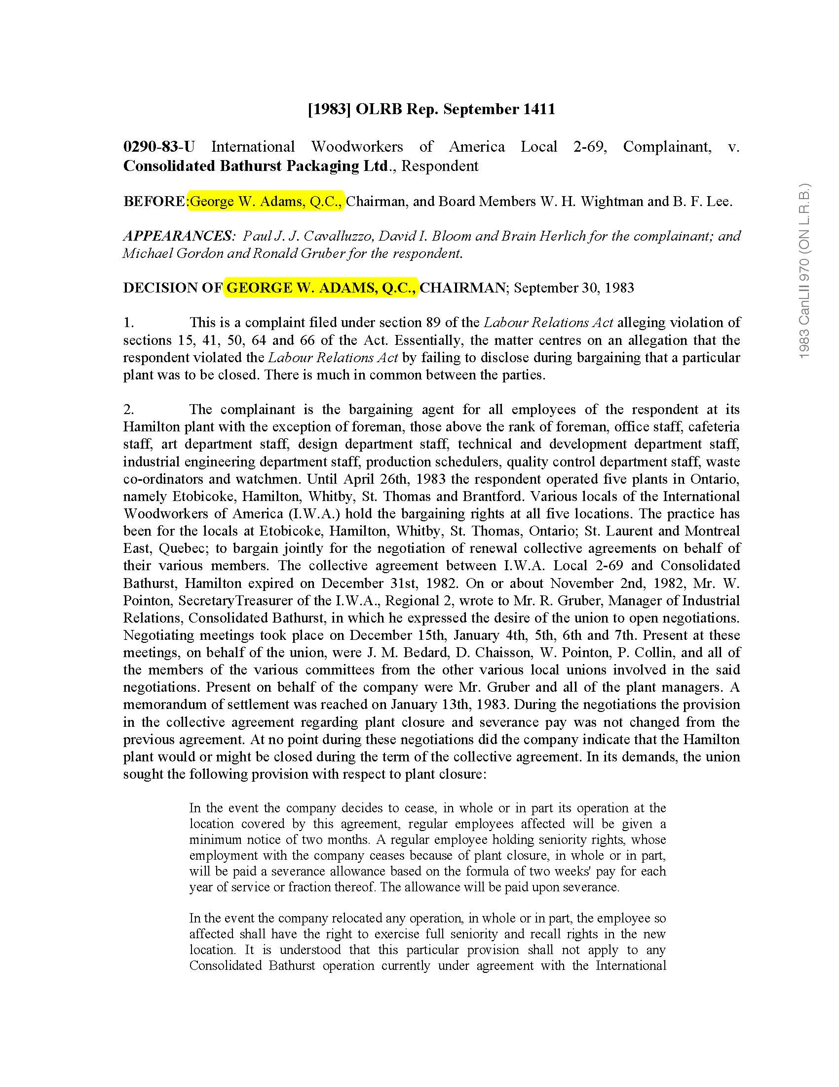

Slide 7

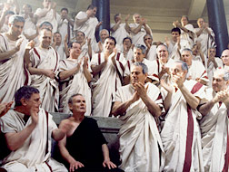
The Full Board
“facilitate a maximum understanding and appreciation throughout the Board of policy developments and to evaluate fully the practical consequences of proposed policy initiatives on labour relations and the economy in the Province”
But panel “to make the ultimate decision” and “discussion at a Full Board meeting is limited to the policy implications of a draft decision”
Draft decision, no vote, no attendance, no minutes
“The meetings invariably conclude with the Chairman thanking the members of the panel for outlining their problem to the entire Board and indicating that all Board members look forward to that panel’s final decision whatever it might be.” Well, in that case…
“Bad” Alternative:
  “driven to discuss … cases informally” !? Oh my! Say it ain’t so!?
We do this all the time: Thursday lunch meetings, convened by The Chairman of the Board, who is also the Chief Executive Officer, to discuss case processing using “computerized case status print-outs”(!)

Slide 8
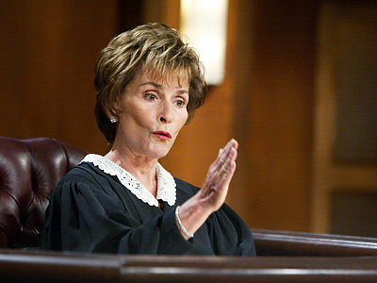
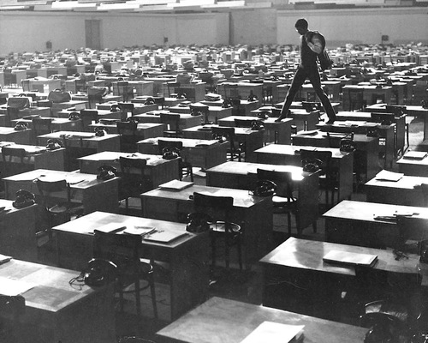
We are just like courts!
Who would dare “probe the mental processes” of judges (or jurors)? No one
  The “inherent nature of judicial decisionmaking (!) and administrative law making (!)” is at stake
  “Is it seriously open for a litigant to question Supreme Court justices or other judges about their post-hearing reading, their thinking, and the contribution of their law clerks or brother judges to the ideas expressed in an opinion published under a justice’s name?” No, of course not…?
  We are important, too! “administrator[s] of an important public statute embracing a complex of socio-economic objectives”
    Contrast (Kafka): “administrative agency manned internally by a host of anonymous civil service advisors”
So (lawyers, courts, anybody) show us some respect/deference!

Slide 9
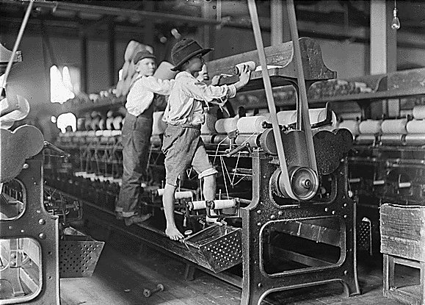
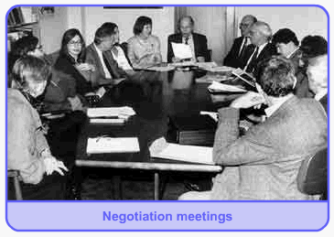
This case
Full Board didn’t go into facts, only policy
  To wit, “unsolicited disclosure in collective bargaining”
    Did employer have to disclose sua sponte plans to close factory?
  “In addition to Board members, the Registrar of the Board and its solicitors may have been in attendance.”(!)
Conclusion: “It is our view that the Full Board meeting procedure described above … comply with the principles of natural justice … and, as well, accord with s. 102(13)…”
  “natural justice, sensibly applied”
Again, Laskin (out with the old): “beginning of labour relations legislation” vs. today (mid-20th c.)
  “so-called right of the individual to bargain individually”

Slide 10
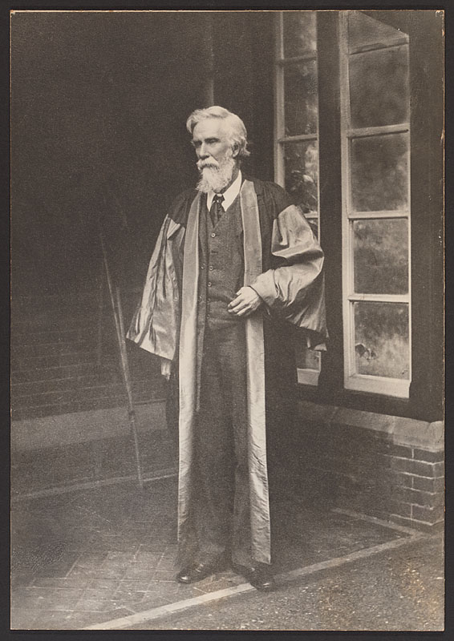
Consolidated Bathurst
Divisional Court (5/85)
He who hears must decide, I say!
Quash OLRB I (9/83) and II (12/83)?
  yes: sending “shock waves through Canadian
  administrative tribunals“…
Substance (no go):
  OLRB I:
    Violation of Labour Relations Act sec. 15:
    The parties … shall bargain in good faith and make every reasonable effort to make a collective agreement.
    Plant closure after agreement, no disclosure
      Unrebutted rebuttable presumption of bad faith
        Nondisclosure “tantamount to a misrepresentation”
    Law: patently unreasonable interpretation of sec. 15 to require disclosure of de facto or contemplated decision to close plant (no go); facts: no evidence (no go)
Process: The Full Board (“he who hears must decide”)
  Self-defense: ORLB as party? (process of process)
    Exercise of statutory power (Osler: jurisdiction, not merits)
      “may be a party”: discretion of the board
        Once a party, discretion of court re: participation in argument (rule of court vs. rule of law)
… or was it the other way ‘round?

Slide 11
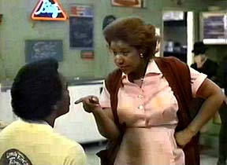

Substance of Process
McRuer report re OLRB (1971)
  Full Board “violation of the principle that he who decides must hear”
Mehr v. Law Soc’y Upper Canada (SCC 55)
  Discipline committee
  Right to be notified and opportunity to be heard
Committee on Works (62)
  Contamination
More Mehr
  Declaration of no effect irrelevant: “A Judge must not take upon himself to say, whether evidence improperly admitted had or had not an effect upon his mind.”
Facts vs. norm (policy)
  “until the Board decides what the test is the findings of fact cannot be finalized” (What facts are relevant? What is their relevance?)
Audi alteram partem
  Opportunity to present and comment on evidence
  102(13) The Board shall determine its own practice and procedure but shall give full opportunity to the parties to any proceedings to present their evidence
    Statutory interpretation at its finest: competitive highlighting!
R-E-S-P-E-C-T:
  “without in any way doubting the sincerity and integrity of the Chairman”
  “declaration [re: panel’s independent decision], although of course I accept it as made in perfect good faith”

Slide 12
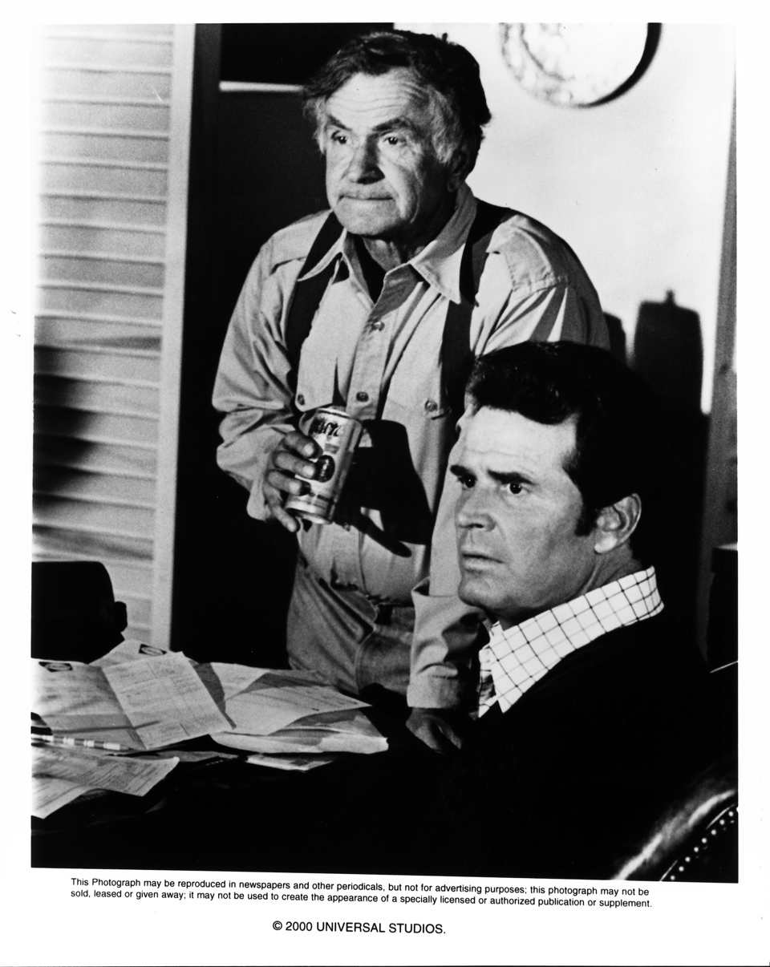
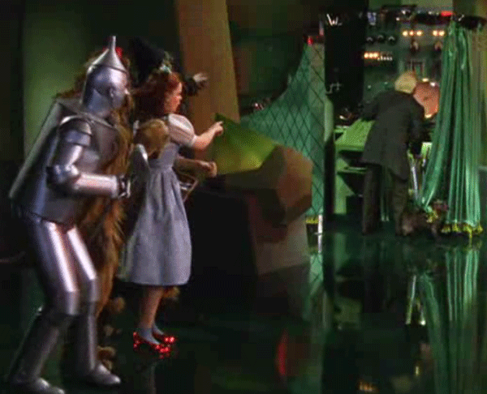
Osler dissent…
The Plain Brown Envelope (P.I., the sequel)
  “a document that appeared to be, or might be taken to be, a draft decision of the Board”
  hearsay!
  Incalculable effect (ad absurdum: memos, notes…)
  Secrecy vs.
  publicity/transparency (Baker)
    Prudence vs. justice

Slide 13

Same old, same old
Expertise (Willis); legislative intent
  The Legislature has obviously decided that such a body, bringing to its work the background and experience of individuals representative of employers and employees, and sworn to carry out their duties under the Act, constitutes a body which can more appropriately administer the Act than can the Courts.
Distinctions
  McRuer report cuts the other way: Legislature didn’t act!
  Precedent does too…
    persons who had not heard the evidence or submissions were present on the occasion when the decision was made and did participate in the decision, or may have done so [not so here]
    taking of evidence or submissions in the absence of, and unknown to, one of the participants [not so here either]
    No precedent that decision makers, sworn to do their duty, are prohibited from discussing with colleagues, formally or informally, cases that comes before them so long as those colleagues, who have not heard the evidence or submissions, do not participate in the actual decision.
      Judges, too, chat: “consultation, frequently informal but occasionally formal”
        Circulation of draft opinions
    Respect: Onus on complainant to produce proof of inaccuracy of Adams’s account
Protection of board decision vs. protection of secrecy (jury)?
Since 1971 (14 years): “It is not known to have been
challenged and this in itself argues its practicability.”
… and its justice?

Slide 14


Court of Appeal (9/86)
“I find that I am in agreement with the reasons and conclusion of Osler J.” …
  “tribunals … breathe a collective sigh of relief”

Slide 15
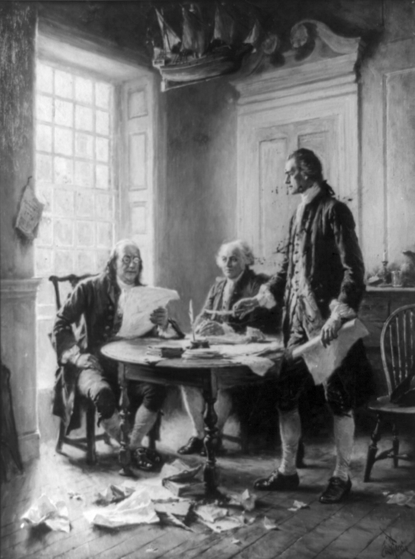
The Board at Work
Sensitive, emotional, important: busy, busy, busy
Speed, consistency—certainty
Preamble: “decisions of the Board go beyond the rights of the particular parties” (!)
  Industrial peace vs. individual rights
Full Board:
  Experts
  tripartite membership: “no breach of the principles of natural justice during those discussions”
Deference
  Legislative intent
    102(13): Board sets procedures…
    108: strong privative clause (current version: sec 116. No decision, order, direction, declaration or ruling of the Board shall be questioned or reviewed in any court, and no order shall be made or process entered, or proceedings taken in any court … to question, review, prohibit or restrain the Board or any of its proceedings.)
    Exc. natural justice (“full and fair hearing”)…

Slide 16

No natural justice problem
He who hears must decide not applicable
  Nothing heard, nothing decided
  No new evidence
  No new ideas
    So what’s the point of the Full Board?
    What is an idea? What makes it new?
Common sense over natural justice
… I repeat that I agree with the reasons and conclusion of Osler J….

Slide 17
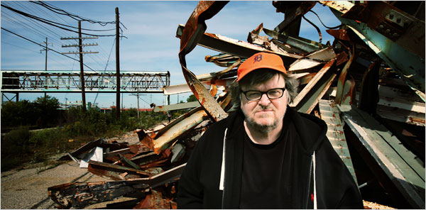
Can Sup Ct (3/90)
Gonthier, J.
Facts
  Negotation: nondisclosure sua sponte of planned plant closure (“good faith”)
  Policy issues
    Westinghouse (“de facto decision”, “hard decision”)
    Consolidated: reconsider Westinghouse “test”
      Union: “seriously considering”
      Employer: “definitive decision”
  Full board (“the impugned meeting”): what Adams said
    “There is no evidence that the particular meeting impugned in this case was used to impose any given opinion upon the members of the panel, or that the spirit of discussion and exchange sought through those meetings was not present during those deliberations.”

Slide 18

More Gonthier
Analysis
  Two rules of natural justice
    (1) Nemo iudex in causa sua
      Independence of panel members
    (2) Audi alteram partem
  Context: “institutional constraints” (NJ’s flexibility)
    Efficiency coin of the realm: “tribunals created to increase the efficiency of the administration of justice”
      full board meeting vs. full board hearing
      Accumulation of experience; coherence
    Full board: good enough for gov’t work
      “Like many other judicial practices … full Board meetings entail some imperfections …”

Slide 19
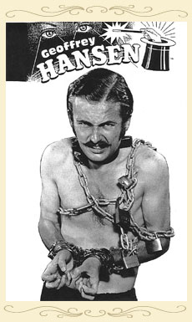
Yet More Gonthier
(1) nemo iudex
  “maxim” (vs. principle)
    he [and only he] who hears must decide
  No problem: panel members heard all the evidence and submissions (he who decides must hear), board members who didn’t hear all the evidence and submissions didn’t “participate” in decision (only he who hears may decide)
  crux: panel’s independence fettered (influence vs. participation)?
    No:
      “moral suasion” vs. imposition
        “absence of influence” vs. “freedom to decide according to one’s own conscience and opinions”
      full board upon request vs. imposition
      “carefully designed to foster discussion without trying to verify whether a consensus has been reached: no minutes are kept, no votes are taken, attendance is voluntary and presence … not recorded” [these are all good things!]

Slide 20

Gonthier, The End
(2) audi alteram partem
  Full board meetings:
  “some disadvantages from the point of view of the audi
  alteram rule”…
  Evidence: nothing new
    “as a general rule” no participation in discussion of evidence
      But “less problematic” if no participation in final decision…
  Policy: new may be good!
    Contra Court of Appeal--can too discuss policy w/o discussing facts
      “The purpose of policy discussions is not to determine which of the parties will eventually win the case, but rather, to outline the various legal standards which may be adopted by the Board… Since [policy] issues involve the consideration of statutes, past decisions and perceived social needs, the impact of a policy decision by the Board is, to a certain extent, independent from the immediate interests of the parties, even though it has an effect on the outcome of the complaint.”
        Government in miniature (Willis…)
    But: if new policy [or evidence!], then parties must have opportunity to respond
      “reasonable opportunity,” perhaps supplementary hearing…
    But: “obvious practical reasons”—can’t solicit response “every time an argument is discredited,” esp. given tribunals’ “specialized knowledge and expertise”
Application to this case:
  Nothing new (policy or evidence), so nothing to respond to…

Slide 21

Sopinka dissent (+ Lamer)
What’s the issue, exactly? Rules/principles of natural justice
  (a) he who decides must hear
  (b) the right to know the case to be met
    no submissions
“full Board meeting might very well have affected the outcome”
  Burden of proof? “refute the inference” of vs. establish influence (72)
    Point of Full Board is to influence
    Contrast Gonthier: “There is no evidence that the particular meeting impugned in this case was used to impose any given opinion upon the members of the panel…”

Slide 22

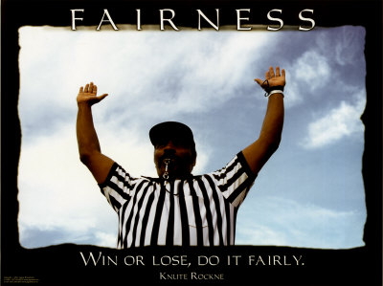

Sopinka 2
The two rules have the same purpose: to preserve the integrity and fairness of the process.
  New policy considerations introduced by non-hearers
  Application of these considerations by hearers
    w/o parties’ opportunity to address
What natural justice is due?
  Factors:
    Classification no longer dispositive
      that’s a good thing, too… (hybrid: quasi-judicial/administrative)
    Serious civil consequences (reopening plant, damages)
  Applied:
    Opportunity to be heard re: policy that may have been developed at full board meeting
      Remedy? Could full board meeting ever comply with natural justice? Legislative authorization (Ocean Port)?
      Uniformity vs. natural justice
+
=

Slide 23

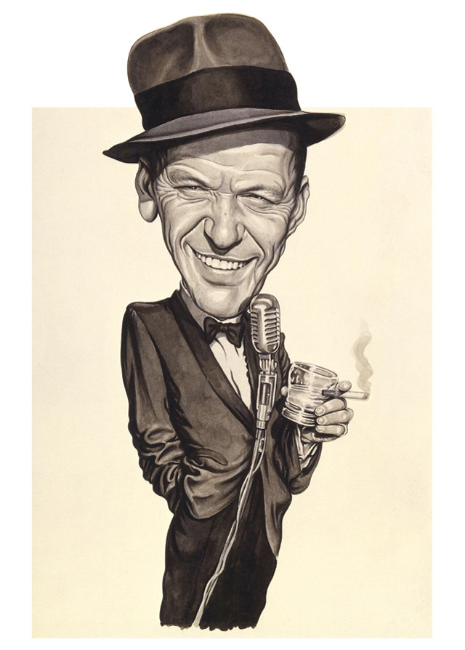
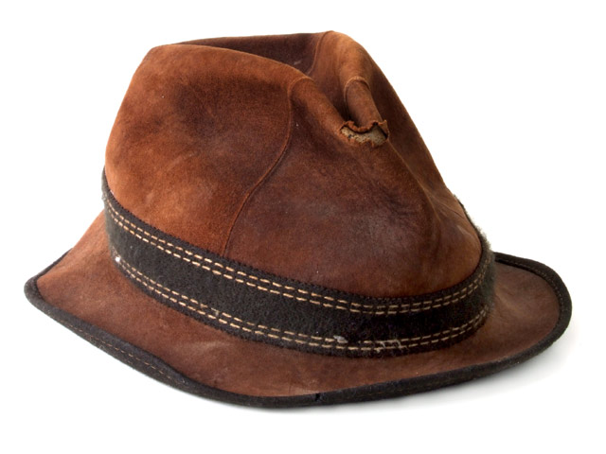
The Baker Factors…
nature of the decision being made and the process followed in making it
  The more (judicial), the more (rights); the more (administrative/legislative), the fewer (rights)
  E.g., application of specific rules to a particular case vs. broader social or economic policy?
nature of the statutory scheme and the “terms of the statute pursuant to which the body operates”
  E.g., no appeal; privative clause
the importance of the decision to the individual or individuals affected
  Employer (Consolidated-Bathurst) = “individual(s)”?
legitimate expectations of the person challenging the decision
  Full Board = old hat
agency’s choice of procedures
  Chairman of the Board
list not exhaustive

Slide 24
Sopinka: Last and Least
Sec. 114. No proceedings under this Act are invalid by reason of any defect of form or any technical irregularity and no such proceedings shall be quashed or set aside if no substantial wrong or miscarriage of justice has occurred.
  Burden of proof on board to established harmless error (nothing new at full board meeting)
Sec. 102(13): The Board shall determine its own practice and procedure but shall give full opportunity to the parties to any proceedings to present their evidence and to make their submissions …
  … “when the rules of natural justice collide with a practice of the Board, the latter must give way”

Slide 25
Sopinka dissent (+ Lamer)
What’s the issue, exactly? Rules/principles of natural justice
  (a) he who decides must hear
  (b) the right to know the case to be met
    no submissions
“full Board meeting might very well have affected the outcome”
  Burden of proof? “refute the inference” of vs. establish influence (72)
    Point of Full Board is to influence
    Contrast Gonthier: “There is no evidence that the particular meeting impugned in this case was used to impose any given opinion upon the members of the panel…”

Slide 26
Sopinka 2
The two rules have the same purpose: to preserve the integrity and fairness of the process.
  New policy considerations introduced by non-hearers
  Application of these considerations by hearers
    w/o parties’ opportunity to address
What natural justice is due?
  Factors:
    Classification no longer dispositive
      that’s a good thing, too… (hybrid: quasi-judicial/administrative)
    Serious civil consequences (reopening plant, damages)
  Applied:
    Opportunity to be heard re: policy that may have been developed at full board meeting
      Remedy? Could full board meeting ever comply with natural justice? Legislative authorization (Ocean Port)?
      Uniformity vs. natural justice
+
=

Slide 27
The Baker Factors…
nature of the decision being made and the process followed in making it
  The more (judicial), the more (rights); the more (administrative/legislative), the fewer (rights)
  E.g., application of specific rules to a particular case vs. broader social or economic policy?
nature of the statutory scheme and the “terms of the statute pursuant to which the body operates”
  E.g., no appeal; privative clause
the importance of the decision to the individual or individuals affected
  Employer (Consolidated-Bathurst) = “individual(s)”?
legitimate expectations of the person challenging the decision
  Full Board = old hat
agency’s choice of procedures
  Chairman of the Board
list not exhaustive

Slide 28
Sopinka: Last and Least
Sec. 114. No proceedings under this Act are invalid by reason of any defect of form or any technical irregularity and no such proceedings shall be quashed or set aside if no substantial wrong or miscarriage of justice has occurred.
  Burden of proof on board to established harmless error (nothing new at full board meeting)
Sec. 102(13): The Board shall determine its own practice and procedure but shall give full opportunity to the parties to any proceedings to present their evidence and to make their submissions …
  … “when the rules of natural justice collide with a practice of the Board, the latter must give way”

