Slide 1
Administrative Law
Markus Dubber

Slide 2
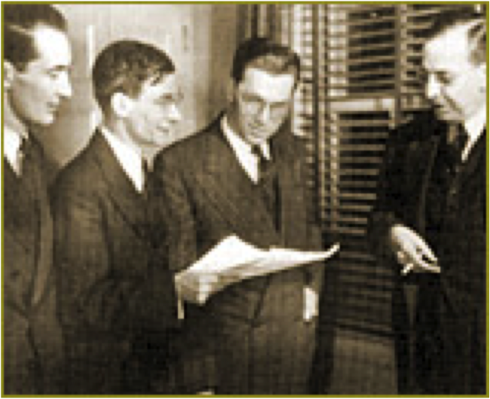
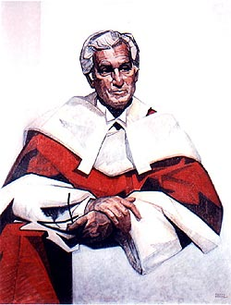
Nicholson v. Haldimand-Norfolk
[1979] 1 S.C.R. 311
Laskin, C.J. (yes, that Laskin)
[5-to-4]
Hired March 1, 1973, one year probation, promoted March 1, 1974, fired in letter of June 10, 1974 (letter from Deputy Chief of Police on behalf of Board of Commissioners of Police)
(1) No reasons, (2) no notice, (3) no hearing
Duty of (procedural) fairness? yes, sort of (natural justice with a small “n” (and a small “j”…)) [halfway house…]
Before
After

Slide 3
The Police Act, R.S.O. 1970, c. 351
sec. 72(1)(a)
[Lieutenant-Governor may make regulations] for the government of police forces and governing the conduct, duties, suspension and dismissal of members of police forces.
Regulation 680
sec. 27. No chief of police, constable or other police officer is subject to any penalty under this Part except after a hearing and final disposition of a charge on appeal as provided by this Part, or after the time for appeal has expired, but nothing herein affects the authority of a board or council,
(a) subject to the consent of the Commission, to dispense with the services of any member of a police force for the purpose of reducing the size of or abolishing the police force, where the reduction or abolition is not in contravention of the Act;
(b) to dispense with the services of any constable within eighteen months of his becoming a constable; …
(e) to discharge or place on retirement, if he is entitled thereto, any member of the force who, on the evidence of two legally qualified medical practitioners is, due to mental or physical disability, incapable of performing his duties in a manner fitted to satisfy the requirements of his position but any decision of the board or council made pursuant to this clause may be appealed to the Commission.

Slide 4

Divisional Court
Natural justice applies to administrative tribunals [ministerial acts] and courts
[judicial acts] alike
  Why? Because Ridge v. Baldwin ([1963] 2 W.L.R. 935, [1964] AC 40) says so
Statutory interpretation
  27(b) as impossible exception
    “Can it be …? I do not believe that it can.”
Natural justice applies to plaintiff
  b/c “office holder” (but not at pleasure…), not servant (not “simply an employee”—see Laskin)
    Independence of police officers?
      Discretion: Compulsory Prosecution (Legalitätsprinzip); vagueness

Slide 5
Ontario Court of Appeal
Statutory interpretation
  27(b): “dispense with”: probationary
    vs. “dismiss” (20(2), 23(7)) or “discharge” (27(e))
  Expressio unius!
    Notice and hearing required elsewhere in statute, therefore…
Constable at common law
  Office holder at pleasure: no right to fairness

Slide 6
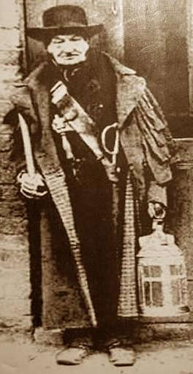

Supreme Court (Laskin)
Office holder, but not at pleasure
  CA’s common law constable analogy “inapt”
  but (obiter dictum): even if at pleasure, entitled to natural justice (20); “anachronistic flavour in the light of collective agreements”
“[T]he frame of the Act and regulations thereunder [“a code for police constables(!)”] has left the words ‘at pleasure’ behind as relics of Crown law which no longer governs the relations of police and Boards or Municipal Councils.”

Slide 7
Supreme Ct. cont’d
Statutory interpretation:
  In so far as the Ontario Court of Appeal based its conclusion on the expressio unius rule of construction, it has carried the maxim much too far. …”[T]he maxim ought not to be applied when its application, having regard to the subject-matter to which it is to be applied, leads to inconsistency or injustice". [mischief maxim?] This statement commends itself to me and I think it relevant to the present case where we are dealing with the holder of a public office, engaged in duties connected with the maintenance of public order and preservation of the peace, important values in any society.
  CA’s statutory interpretation “involved importing the term ‘at pleasure,’ with its connotation (!) of peremptory power of dismissal”
      [I]n so far as the judgment of the Ontario Court of Appeal is based on reading the words “at pleasure” (as importing(!) arbitrary power) into s. 27(b), or the term “probationary” (with similar import), it results in reducing the status of the office of police constable to that involved in a master-servant relationship … I do not regard this as either an obvious or a necessary gloss on s. 27(b).
Instead, focus on absence (of “at pleasure”) [absence means absence vs. absence means presence]
  The dropping of the phrase “at pleasure” from the statutory provision … indicates to me a turning away from the old common law rule even in cases where the full period of time has not fully run. The status employed by the office holder must now be taken to have more substance than to be dependent upon the whim of the Board up to the point where it has been enjoyed for 18 months.

Slide 8

Laskin’s Halfway House
More Rand-talk:
  The effect of the judgment below is that a constable who has served eighteen months or more is afforded protection against arbitrary discipline or discharge through the requirement of notice and hearing and appellate review, but there is no protection at all, no halfway house, between the observance of natural justice aforesaid and arbitrary removal in the case of a constable who has held office for less than eighteen months.
The Halfway House (lower-case natural justice, natural justice lite, mini-NJ…): what, precisely, is Nicholson owed?
  Depends… (fair, not arbitrary…); Goldilock-y: just right
  “If there were too much elaboration of procedural safeguards, nothing could be done simply and quickly and cheaply. Administrative or executive efficiency and economy should not be too readily sacrificed.”
  Classification? quasi-judicial (22)
    Conceptual vs. functional (Mullan…) (23)
    Can’t tell quasi-judicial from judicial from administrative
      Why try? Who cares?

Slide 9

What Nicholson deserved
In my opinion, the appellant should have been told why his services were no longer required and given opportunity, whether orally or in writing as the Board might determine, to respond. The Board itself, I would think, would wish to be certain that it had not made a mistake in some fact or circumstance which it deemed relevant to its determination.
  I can hardly credit [the making of the telephone call of which [his superior officer] disapproved, (and which he said was in disobedience of a direct order…)] in itself could be a reason for dismissing a constable who had served for fifteen months…

Slide 10


Martland dissent
Court of Appeals got it right:
  Statutory interpretation
    At pleasure, probation
  Ridge v. Baldwin involved statute authorizing dismissal of constable for negligence, not at pleasure appointment
Upshot:
  The only interest involved [in the decision] was that of the Board itself. Its decision was purely administrative. This being so, it was under no duty to explain to the appellant why his services were no longer required, or to give him an opportunity to be heard. It could have taken that course as a matter of courtesy, but its failure to do so was not a breach of any legal duty to the appellant.
    conceptual vs. functional?

