Slide 1
Administrative Law
Markus Dubber

Slide 2
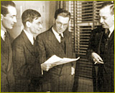
Three Approaches (Willis)
The Situation
The Challenge
The Solution
  Judicial
  Conceptual
  Functional
Hi, I’m John Willis.
And I’m Cecil Wright. Friends call me Caesar.
What am I doing in this picture?
Bora Laskin, yes, that Bora Laskin.

Slide 3
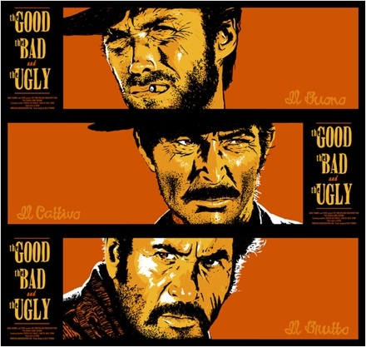

Willis, “Statute Interpretation in a Nutshell” (aka “Three Approaches to Statutory Interpretation”)
(3) Subject Matter (Context²)
(2) Context
(1) Ordinary Meaning

Slide 4

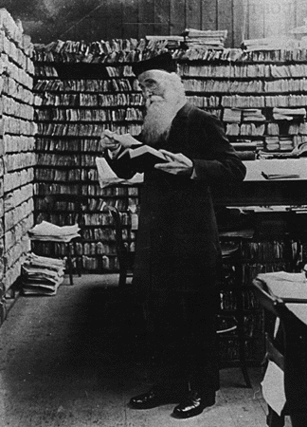
(1) Ordinary Meaning
”What is the meaning of this word when read alone?”
  Dictionaries!
    Statutory dictionaries
      Interpretation Act § 35. (1) In every enactment,
      "Canada"
      «Canada»
      "Canada" , for greater certainty, includes the internal waters of Canada and the territorial sea of Canada
      Model Penal Code § 2.01 (4) Possession is an act, within the meaning of this Section, if the possessor knowingly procured or received the thing possessed or was aware of his control thereof for a sufficient period to have been able to terminate his possession.
    Law dictionaries
      E.g., Jowitt’s Dictionary of English Law (UK); Black’s Law Dictionary (US)
        “remedy” (Vachon v. Canada Employment and Immigration Commission, [1985] 2 S.C.R. 417)
        “execution” (Quebec v. Montreal, [1999] 1 S.C.R. 381)
        definition of “criminal contempt” (BCGEU vs. British Columbia,
        [1988] 2 S.C.R. 214)
    General dictionaries
      Random House (US)
      Webster’s (US)
      Oxford English Dictionary (UK)
    French/English
      Family status/situation de famille (Canada (Attorney General)
      v. Mossop, [1993] 1 S.C.R. 554) (Oxford English Dictionary)
Hi, I’m James Murray, Father of the OED.

Slide 5
(2) Context
”What is the meaning of this word when read together with the rest of the words of the Act?”
  “Words, like people, take their colour from their surroundings.” [quoted in Bell ExpressVu!]
  (a) “Noscitur a sociis” [known by his/her associates]
      a general word takes its colour from the preceding specific words with which it is used [in “stab, cut or wound,” “wound” does not include biting off nose…]
  (b) “Ejusdem generis” [of the same kind]
      a general phrase, such as "or other causes", or "and all kinds of merchandise", takes its colour from the preceding specific words or phrases, and really means "or other causes of the same sort", or "and all kinds of merchandise of the same sort” ["an automobile, automobile truck, automobile wagon, motorcycle, or any other self-propelled vehicle not designed for running on rails” doesn’t include airplane]
  (c) “Expressio unius [est] exclusio alterius” [the expression of one [is] the exclusion of another]
      a general word or phrase takes its colour as well from the specific words or phrases which follow it as from those which precede it [Nicholson…]
Today there is only one principle or approach, namely, the words of an Act are to be read in their entire context and in their grammatical and ordinary sense harmoniously with the scheme of the Act, the object of the Act, and the intention of Parliament. Bell ExpressVu Limited Partnership v. Rex, [2002] 2 S.C.R. 559 (quoting Driedger, Construction of Statutes 87 (2nd ed. 1983))
  Except: Other principles of interpretation -- such as the strict construction of penal statutes and the "Charter values" presumption -- only receive application where there is ambiguity as to the meaning of a provision. …

Slide 6
(3) Subject matter
”What is the meaning of this word when read against the background of that part of human conduct with which the Act is dealing?”
Modern statutes, being for the use of laymen, are framed in wide and general language and consequently fall outside the ambit of the[] rules as to clear meaning.
Where the provision under consideration is found in an Act that is itself a component of a larger statutory scheme, the surroundings that colour the words and the scheme of the Act are more expansive. In such an instance, the application of Driedger's principle gives rise to … "the principle of interpretation that presumes a harmony, coherence, and consistency between statutes dealing with the same subject matter". Bell ExpressVu Limited Partnership v. Rex, [2002] 2 S.C.R. 559

Slide 7
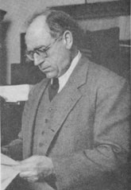
Llewellyn’s Three Ingredients of Statutory Interpretation
I drafted the Uniform Commercial Code.
Current tradition
  Grand Style (principle over precedent)
  Formal Style (precedent over principle)
Current temper
  Love of creativeness
  Love of order
Situation sense
  Accidental sympathy vs. long-range justice for all

Slide 8
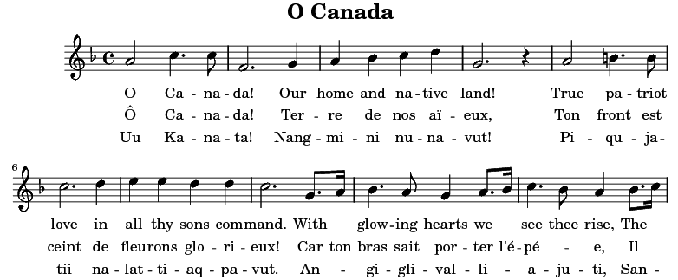
Play that music!
[A] court must strive to make sense as a whole out of our law as a whole. It must … take the music of any statute as written by the legislature; it must take the text of the play as written by the legislature. But there are many ways to play that music, to play that play, and a court’s duty is to play it well, and, in harmony with the other music of the legal system.
Hence, in the field of statutory construction also, there are "correct,” unchallengeable rules of "how to read" which lead in happily variant directions.
This must be so until courts recognize that here, as in case-law, the real guide is Sense-for-All-of-Us. It must be so, so long as we and the courts pretend that there has been only one single correct answer possible. Until we give up that foolish pretense there must be a set of mutually contradictory correct rules on How to Construe Statutes: either set available as duty and sense may require.

Slide 9
Selling a Construction
When it comes to presenting a proposed construction in court, there is an accepted conventional vocabulary. As in argument over points of case-law, the accepted convention still, unhappily requires discussion as if only one single correct meaning could exist. Hence there are two opposing canons on almost every point. An arranged selection is appended. Every lawyer must be familiar with them …: they are still needed tools of argument. …
Plainly, to make any canon take hold in a particular instance, the construction contended for must be sold, essentially, by means other than the use of the canon: The good sense of the situation and a simple construction of the available language to achieve that sense, by tenable means, out of the statutory language.

Slide 10
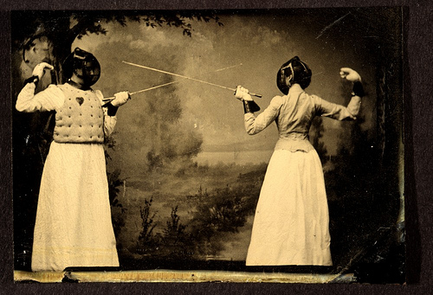

Some Thrusts and Parries
11. Titles do not control meaning; preambles do not expand scope; section headings do not change language.
12. If language is plain and unambiguous it must be given effect.
15. Words are to be taken in their ordinary meaning unless they are technical terms or words of art.
16. Every word and clause must be given effect.
17. The same language used repeatedly in the same connection is presumed to bear the same meaning throughout the statute.
18. Words are to be interpreted according to the proper grammatical effect of their arrangement within the statute. [paragraphs…]
11. The title may be consulted as a guide when there is doubt or obscurity in the body; preambles may be consulted to determine rationale, and thus the true construction of terms; section headings may be looked upon as part of the statute itself.
12. Not when literal interpretation would lead to absurd or mischievous consequences or thwart manifest purpose. [Nicholson?]
15. Popular words may bear a technical meaning and technical words may have a popular signification and they should be so construed as to agree with evident intention or to make the statute operative.
16. If inadvertantly inserted or if repugnant to the rest of the statute, they may be rejected as surplusage.
17. This presumption will be disregarded where it is necessary to assign different meanings to make the statute consistent.
18. Rules of grammar will be disregarded where strict adherence would defeat purpose.

Slide 11

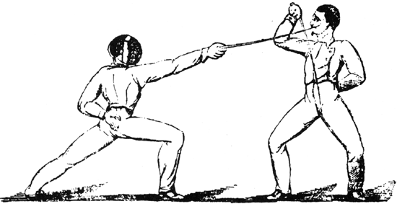
Some More…
20. Expression of one thing excludes another.
[aka expressio unius…]
21. General terms are to receive a general construction.
22. It is a general rule of construction that where general words follow an enumeration they are to be held as applying only to persons and things of the same general kind or class specifically mentioned (ejusdem generis ).
24. Punctuation will govern when a statute is open to two constructions.
27. A proviso qualifies the provision immediately preceding.
20. The language may fairly comprehend many different cases where some only are expressly mentioned by way of example.
21. They may be limited by specific terms with which they are associated or by the scope and purpose of the statute. [aka noscitur a sociis]
22. General words must operate on something. Further, ejusdem generis is only an aid in getting the meaning and does not warrant confining the operations of a statute within narrower limits than were intended.
24. Punctuation marks will not control the plain and evident meaning of language.
27. It may clearly be intended to have a wider scope.

Slide 12
Willis and L’Heureux-Dubé
Willis’s Nutshell’s Nutshell, Maxim of Maxims
  A court invokes whichever of the rules produces a result that satisfies its sense of justice in the case before it.
L’Heureux-Dubé’s LP version
  With the rapid development of modern administrative law, the importance of legal interpretation is continually increasing, in proportion to the growing size of our administrative system and the complexity of the issues it must address. Legal interpretation, as a separate discipline, is therefore bound to become an essential part of the knowledge, skills and abilities that contemporary jurists must possess.
  According to th[e] “modern approach”, consideration must be given at the outset not only to the words themselves but also, inter alia, to the context, the statute's other provisions, provisions of other statutes in pari materia and the legislative history in order to correctly identify the legislature's objective. It is only after reading the provisions with all these elements in mind that a definition will be decided on. This “modern” interpretation method has the advantage of bringing out the underlying premises and thus preventing them from going unnoticed, as they would with the “plain meaning” method.
  Self-defined, self-imposed, self-enforced (by judges); internal self-limitation
  maxims, not principles, prudence, not justice
    Thrusts, parries, tools, approaches, sense

Slide 13

Statutory Maxims of Statutory Interpretation
Interpretation Act: One Statute to Interpret Them All!
  Including itself…
    3.(1) Every provision of this Act applies, unless a contrary intention appears, to every enactment, whether enacted before or after the commencement of this Act. (2) The provisions of this Act apply to the interpretation of this Act.
    15. (1) Definitions or rules of interpretation in an enactment apply to all the provisions of the enactment, including the provisions that contain those definitions or rules of interpretation.
    (2) Where an enactment contains an interpretation section or provision, it shall be read and construed
      (a) as being applicable only if a contrary intention does not appear; and
      (b) as being applicable to all other enactments relating to the same subject-matter unless a contrary intention appears.
    12. Every enactment is deemed remedial, and shall be given such fair, large and liberal construction and interpretation as best ensures the attainment of its objects.

Slide 14
Driedger Driedger Driedger
* British Columbia (Workers' Compensation Board) v. British Columbia (Human Rights Tribunal), 2011 SCC 52: We must interpret the words of the provision "in their entire context and in their grammatical and ordinary sense harmoniously with the scheme of the Act, the object of the Act, and the intention of Parliament": … quoting E. A. Driedger, Construction of Statutes (2nd ed. 1983), at p. 87.
* Fraser v. Ontario, 2011 SCC 20: This Court's approach to statutory interpretation has long held that "the words of an Act are to be read in their entire context and in their grammatical and ordinary sense harmoniously with the scheme of the Act, the object of the Act, and the intention of Parliament" … citing Elmer Driedger in Construction of Statutes (2nd ed. 1983)).
* R. v. Ahmad, 2011 SCC 6: This Court has repeated on numerous occasions that "the words of an Act are to be read in their entire context and in their grammatical and ordinary sense harmoniously with the scheme of the Act, the object of the Act, and the intention of Parliament": E. A. Driedger in Construction of Statutes (2nd ed. 1983), at p. 87.
* R. v. Craig, 2009 SCC 23: In E. A. Driedger's oft-quoted formulation, the words of a provision must be read "harmoniously with the scheme of the Act, the object of the Act, and the intention of Parliament": … citing Construction of Statutes (2nd ed. 1983), at p. 87.
* R. v. Middleton, 2009 SCC 21: This Court has often reiterated its preferred formulation of the modern principle of statutory interpretation: "... the words of an Act are to be read in their entire context and in their grammatical and ordinary sense harmoniously with the scheme of the Act, the object of the Act, and the intention of Parliament": … quoting E. A. Driedger, Construction of Statutes (2nd ed. 1983), at p. 87. ETC ETC ETC

