Slide 1
Administrative Law
Markus Dubber

Slide 2
Roncarelli v. Duplessis
[1959] S.C.R. 121
6-to-3 (Martland, Locke, Kerwin, Rand, Judson, Abbott; Taschereau, Cartwright, Fauteux)
Rand concurrence
Cartwright, Fauteux, Taschereau dissents

Slide 3
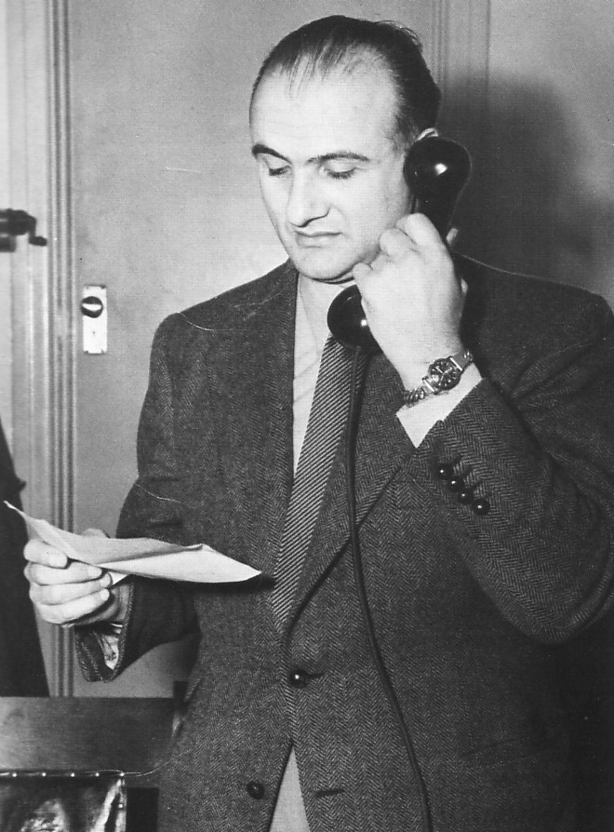
Roncarelli: Administrative Law in Miniature
What is Administrative Law?
  Law/police, three approaches, public/private
Rule of Law, Separation of Powers, and Statutory Interpretation
Procedural Justice and Duty of Fairness
Bias and Independence
Deference and Standards of Review
Statutory Discretion
Regulatory Rulemaking
Who you gonna call? Roncarelli!

Slide 4
Roncarelli: Police
Status
  License
    Liquor, “peddling” wares
    Province, local by-laws
    privilege
  “good education and repute”
    fitness
  Denied forever
    Outlawry (42)
  Jehovah’s Witnesses
    Offensive
  Good faith (R41, 45-46)
    Character
  Fraud/corruption (R41), malice (R42)
Bail, give security/surety
Bureaucracy
  Order
    Employee at will
  Informal
Commission/corporation
  General manager
  “may refuse to grant any permit”
    No rules (C125)
    Unfettered discretion (C128)
Moral police
  Liquor
  Religious offense
Treason (seditious libel) (C113)
Administrative (not (quasi-)judicial) (C125)
  Administrative tribunals based their “decisions and orders, not on legal rights and liabilities, but on policy and expediency.” (C126)
  “law unto itself” (C126)
Justice of the Peace (C130)
  Judicial police power (e.g., common law misdemeanor)

Slide 5
Roncarelli: Maxim of Police Maxim
[T]here would be an end of the commission of the peace, for no man would act therein. Indeed he is answerable to the public if he misbehaves himself, and wilfully, knowingly and maliciously injures or oppresses the King’s subjects, under colour of his office, and contrary to law: but he cannot be answerable to every individual… Every plaintiff in an action must have an antecedent right to bring it; the plaintiff here has no right to have a licence, unless the justices think proper to grant it, therefore he can have no right of action against the justices for refusing it. (C130)

Slide 6
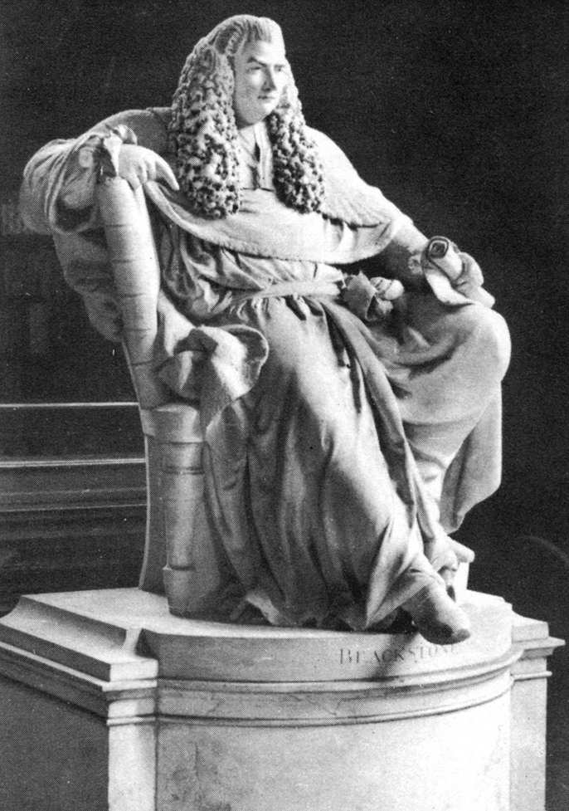

Slide 7
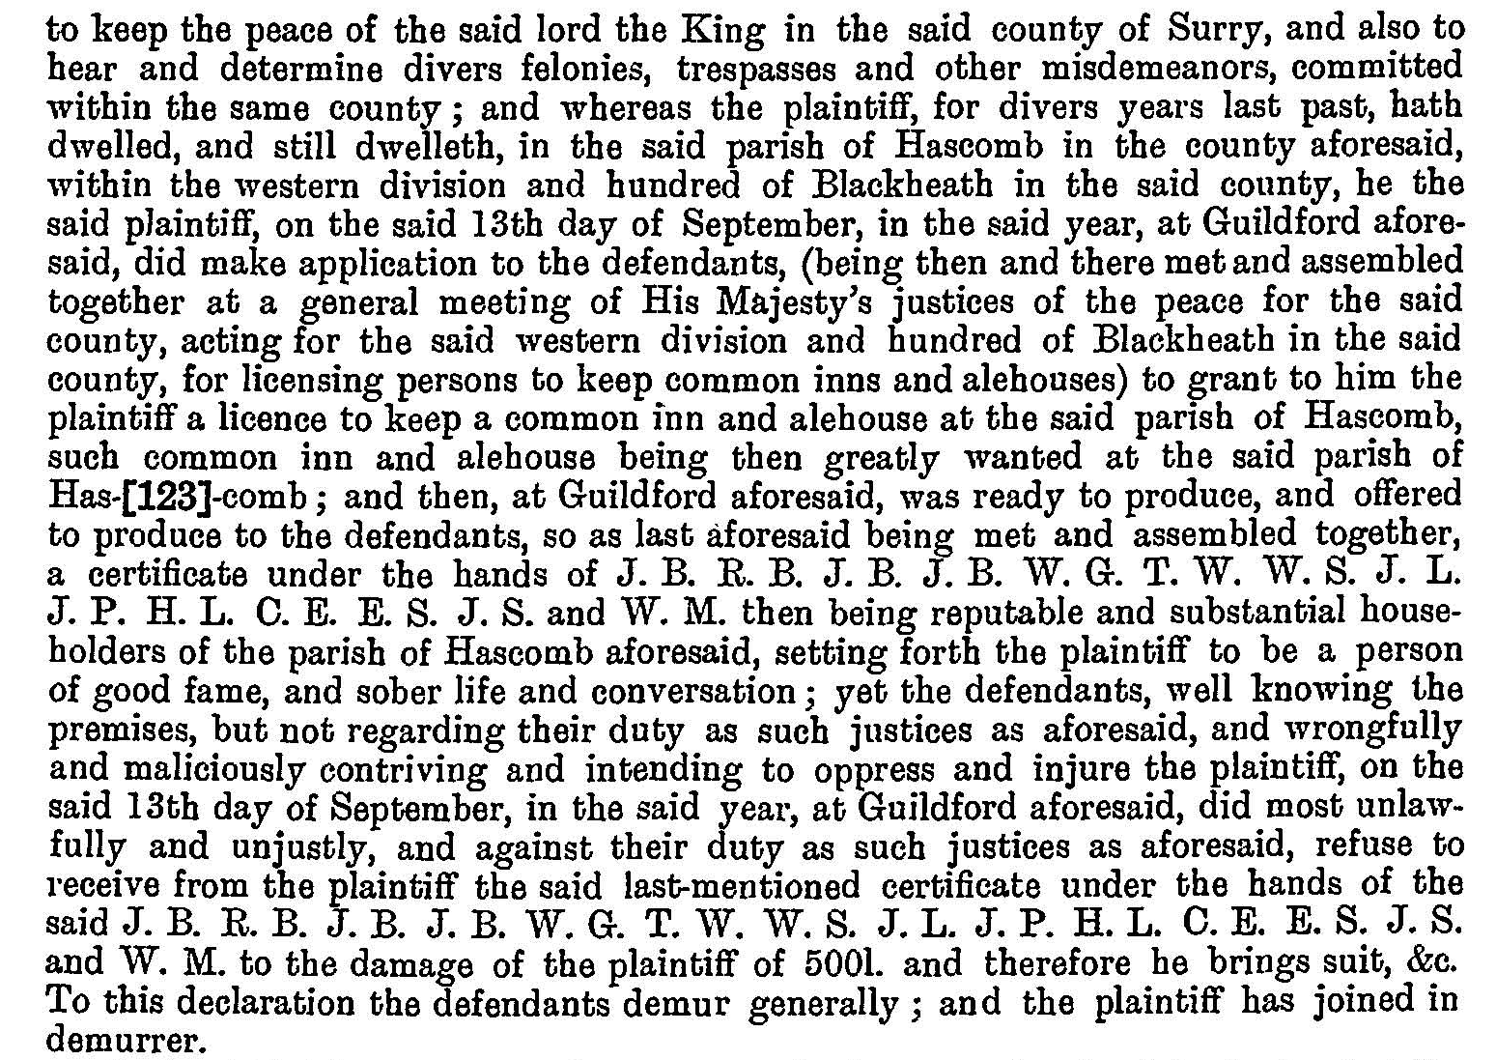

Slide 8
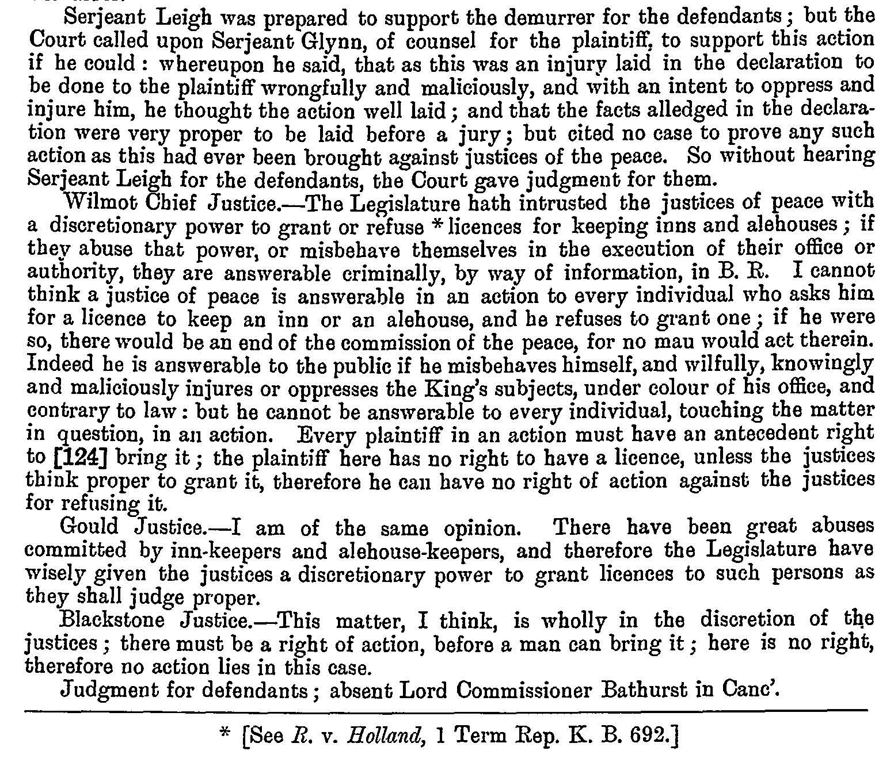

Slide 9
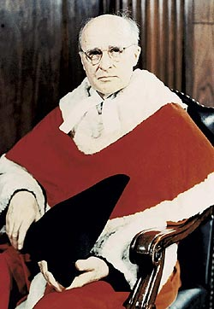
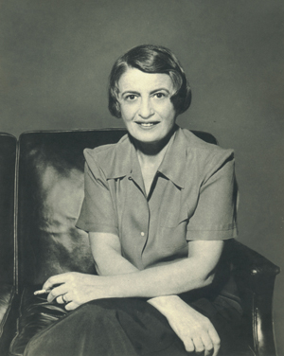
Roncarelli: Law
Citizen (R37, 42)
Legal redress (R37)
Reliance (dependence) (R39)
  From police to law; from privilege to right
Commission’s “duty to serve [statutory] purposes and those only” (R40)
Justification (in statutory language (R50)
“Absolute and untrammeled ‘discretion’; unlimited arbitrary power exercisable for any purpose, however capricious or irrelevant, regardless of the nature or purpose of the statute” (R40)
“A tribunal that dispenses justice, i.e., every judicial tribunal, is concerned with legal rights and liabilities, which means rights and liabilities conferred or imposed by ‘law’; and ‘law’ means statute or long-settled principles. These legal rights and liabilities are treated by a judicial tribunal as pre-existing…” (C126)
(quasi-)judicial
Good faith (mistake)

Slide 10
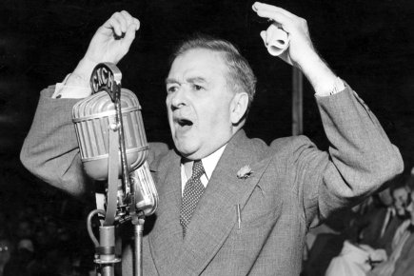
Roncarelli: Rule of Law Rule
The act of the respondent through the instrumentality of the Commission … was a gross abuse of legal power …. That, in the presence of expanding administrative regulation of economic activities, such a step and its consequences are to be suffered by the victim without recourse or remedy, that an administration according to law is to be superseded by action dictated by and according to the arbitrary likes, dislikes and irrelevant purposes of public officers acting beyond their duty, would signalize the beginning of disintegration of the rule of law as a fundamental postulate of our constitutional structure. [A]t this stage of developing government it would be a danger of high consequence to tolerate such a departure from good faith in executing the legislative purpose. (R44)

Slide 11
Alcoholic Liquor Act, R.S.Q. 1941, c. 255
Sec. 5 A Commission is by this act created under the name of "The Quebec Liquor Commission", or "Commission des liqueurs de Québec", and shall constitute a corporation, vested with all the rights and powers belonging generally to corporations.
The exercise of the functions, duties and powers of the Quebec Liquor Commission shall be vested in one person alone, named by the Lieutenant-Governor in Council, with the title of manager. The remuneration of such person shall be determined by the Lieutenant-Governor in Council and be paid out of the revenues of the Liquor Commission.
Sec. 9 The function, duties and powers of the Commission shall be the following: …
d. To control the possession, sale and delivery of alcoholic liquor in accordance with the provisions of this act;
e. To grant, refuse, or cancel permits for the sale of alcoholic liquor or other permits in regard thereto, and to transfer the permit of any person deceased; …

Slide 12
Liquor Act
Sec. 32 No permit shall be granted other than to an individual, and in his personal name.
The application for a permit may be made only by a British subject, must be signed by the applicant before witnesses, and must give his surname, Christian names, age, occupation, nationality and domicile, the kind of permit required and the place where it will be used, and must be accompanied by the amount of the duties payable upon the application for the permit. The applicant must furnish all additional information which the Commission may deem expedient to ask for…
All applications for permits must be addressed to the Commission before the 10th of January in each year, to take effect on the 1st of May in the same year.
Sec. 34 1. The Commission may refuse to grant any permit.
2. The Commission must refuse to grant any permit for the sale of alcoholic liquor in any municipality where a prohibition by-law is in force.

Slide 13
Liquor Act
Sec. 35 1. Whatever be the date of issue of any permit granted by the Commission, such permit shall expire on the 30th day of April following, unless it be cancelled by the Commission before such date, or unless the date at which it must expire be prior to the 30th of April following.
The Commission may cancel any permit at its discretion.
2. [T]he cancellation of a permit shall entail the loss of the privilege conferred by such permit, and of the duties paid to obtain it, and the seizure and confiscation by the Commission of the alcoholic liquor found in the possession of the holder thereof, and the receptacles containing it, without any judicial proceedings being required for such confiscation…
5. Save in the case where a permit is granted to an individual on behalf of a partnership or corporation, in accordance with section 32, the Commission must cancel every permit made use of on behalf of any person other than the holder.

Slide 14
Liquor Act
Sec. 36 The Commission must cancel a permit:
1. Upon the production of a final condemnation, rendered against the permit-holder, his agent or employee, for selling, in the establishment, alcoholic liquor manufactured illegally or purchased in violation of this act;
2. Upon the production of three final condemnations rendered against the permit-holder for violation of this act;
3. If it appears that the permit-holder has, without the Commission's authorization, transferred, sold, pledged, or otherwise alienated the rights conferred by the permit.

Slide 15
Civil Code of Lower Canada
Art. 1053. Every person capable of discerning right from wrong is responsible for the damage caused by his fault to another, whether by positive act, imprudence, neglect or want of skill.
[Today sec. 1457. Quebec Civil Code: Every person has a duty to abide by the rules of conduct which lie upon him, according to the circumstances, usage or law, so as not to cause injury to another. Where he is endowed with reason and fails in this duty, he is responsible for any injury he causes to another person by such fault and is liable to reparation for the injury, whether it be bodily, moral or material in nature.]

Slide 16
Code of Civil Procedure
Art. 88. No public officer or other person fulfilling any public function or duty can be sued for damages by reason of any act done by him in the exercise of his functions, nor can any verdict or judgment be rendered against him, unless notice of such action has been given him at least one month before the issue of the writ of summons.

Slide 17
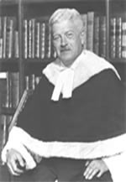
Complexification 1
Rules of Law 1: Fauteux
  Public law vs. private law (personal liability)
    Immunity (Dicey)
  Procedure vs. substance
    Art. 88 Code of Civil Procedure
  Procedure over substance; substance over procedure?

Slide 18

Complexification 2
Rules of Law 2: Rand 2.0 (“The Bold”)
  Judicial role (Fauteux)
  I wish I could; Fugitive Slave Cases
  Honesty/transparency
    Legal Realism
    Balance interests
      Encourage settlement (art. 88)
      De facto (substantive) notice

Slide 19
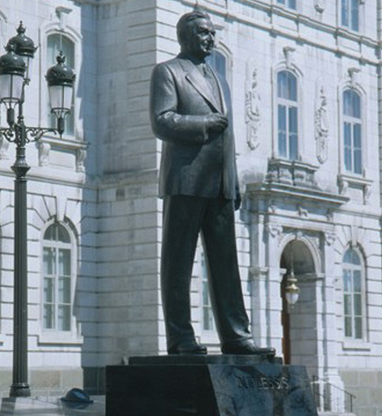
Complexification 3
Policing (Duplessis) via the Rule of Law
  “respectful adjudication”; deference as respect; non-deference as disrespect
    Plain meaning: art. 88 does not apply (Rand); art. 88 does apply (Taschereau)
  Quebec; Catholic
  Unfitness (Duplessis): “arbitrary,” “departure from good faith”
  Warren Court and US South
  Judiciary vs. executive (Duplessis);
  judiciary vs. legislature (art. 88)
    Judiciary: Rulers of law, not ruled
Look, I’m a statue, too!

Slide 20
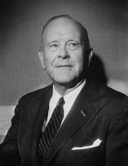
Rule of Law?
Horwitz
  Douglas Hay: the "rule of law" as an ideology required the English ruling classes to accept a degree of self-limitation in order to govern effectively. [U]se of legal ideology as a means of social control required that it be believed and acted upon by both higher and lower classes.
  E.P. Thompson: [T]here is a difference between arbitrary power and the rule of law. We ought to expose the shams and inequities which may be concealed beneath this law. But the rule of law itself, the imposing of effective inhibitions upon power and the defence of the citizen from power's all-intrusive claims, seems to me to be an unqualified human good. To deny or belittle this good is, in this dangerous century when the resources and pretensions of power continue to enlarge, a desperate error of intellectual abstraction.
Altman (Critical Legal Studies)
  Law vs. politics/morals; “correct” legal solution (Llewellyn); judges impose political and moral views under cover of law
  Indeterminate legal rules don’t determine cases; political/moral views do
  Law rule fetishism
Fuller: Managerial direction vs. rule of law
  Rules
  Publicity
  Prospectivity
  Understandability
  Consistency
  Possibility
  Constancy
  Congruence
I also had a famous debate with H.L.A. Hart.
You may know me from…Contracts

