Slide 1
Administrative Law
Markus Dubber

Slide 2
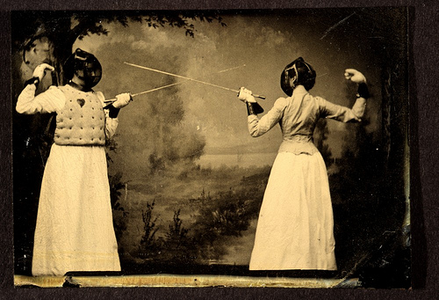
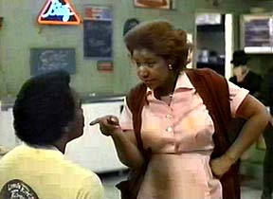
Mossop (1985-93):
Let the Substance Begin, or Has It Already?…
Some useful (…) distinctions in administrative law
Substance vs. process
  the substance of process
    rule of law vs. rule of process vs. rule by judges
    Does process matter?
    Does substance matter?
  the trouble with substance
    Roncarelli; legitimacy
Law vs. mixed fact/law vs. fact
  Rule vs. application
    Scope/flexibility of norm (rule vs. standard)
  Relevance? (standard of review; deference)
Jurisdiction vs. non-jurisdiction
  merits vs. scope (beyond the pale)
  Intent (R-E-S-P-E-C-T) (vs. legislature/admin trib)
Judicial vs. administrative (executive, ministerial) vs. legislative
  Nicholson

Slide 3
Canadian Human Rights Act
2. The purpose of this Act is to extend the laws in Canada to give effect, within the purview of matters coming within the legislative authority of Parliament, to the principle that every individual should have an equal opportunity with other individuals to make for himself or herself the life that he or she is able and wishes to have, consistent with his or her duties and obligations as a member of society, without being hindered in or prevented from doing so by discriminatory practices based on race, national or ethnic origin, colour, religion, age, sex, marital status, family status, disability or conviction for an offence for which a pardon has been granted.
3. (1) For all purposes of this Act, race, national or ethnic origin, colour, religion, age, sex, marital status, family status, disability and conviction for which a pardon has been granted are prohibited grounds of discrimination.
7. It is a discriminatory practice, directly or indirectly, …
(b) in the course of employment, to differentiate adversely in relation to an employee, on a prohibited ground of discrimination.
9. (1) It is a discriminatory practice for an employee organization on a prohibited ground of discrimination
(c) to limit, segregate, classify or otherwise act in relation to an individual in a way that would deprive the individual of employment opportunities, or limit employment opportunities or otherwise adversely affect the status of the individual, where the individual is a member of the organization or where any of the obligations of the organization pursuant to a collective agreement relate to the individual.
10. It is a discriminatory practice for an employer, employee organization or organization of employers
(b) to enter into an agreement affecting recruitment, referral, hiring, promotion, training, apprenticeship, transfer or any other matter relating to employment or prospective employment,
that deprives or tends to deprive an individual or class of individuals of any employment opportunities on a prohibited ground of discrimination.
Collective Agreement
2.01 For the purpose of this Agreement,
(s) a "common-law spouse" relationship is said to exist when, for a continuous period of at least one year, an employee has lived with a person of the opposite sex, publicly represented that person to be his/her spouse, and lives and intends to continue to live with that person as if that person were his/her spouse.
19.02 For the purpose of this clause, immediate family is defined as father, mother, brother, sister, spouse (including common-law spouse resident with the employee), child (including child of common-law spouse), or ward of the employee, father-in-law, mother-in-law, and in addition a relative who permanently resides in the employee's household or with whom the employee permanently resides.
(a) Where a member of his immediate family dies, an employee shall be granted bereavement leave for a period of up to four (4) consecutive days and not extending beyond the day following the funeral. During such period he shall be granted special leave with pay for those days which would have been regularly scheduled working days. In addition, he may be granted up to three (3) days' special leave with pay for the purpose of travel to and from the place of the funeral.

Slide 4
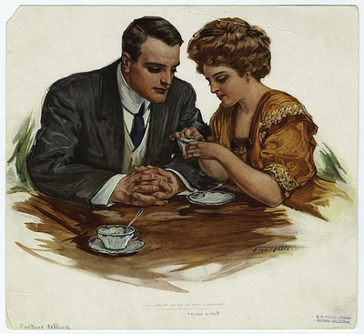
Mossop: HR Tribunal
(M. Elizabeth Acheson)
Mossop, translator for Secretary of State, accompanies long-term male partner to father’s funeral; requests “bereavement leave” day for funeral of “immediate family” member; denied, but gets “special leave“ day instead
  special leave grant irrelevant: respect
    Matter of right, matter of discretion
Grievance, supported by union, denied
Mossop files HR complaints re: discriminatory practice on prohibited ground of family status vs.
  (1) DSS, based on 7(b), 10(b),
  (2) union, based on 9(1)(c)(ii), 10(b)

Slide 5
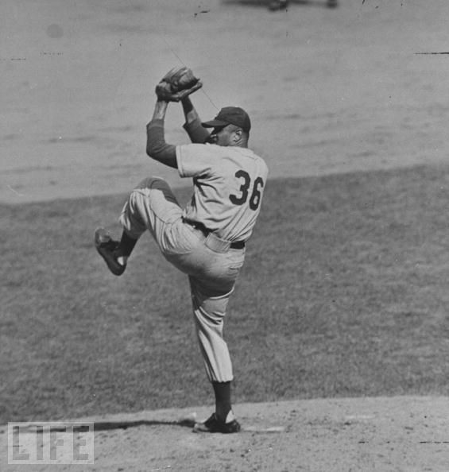
Structure of tribunal decision
Expert (Dr. Margit Eichler)
  “Author of only textbook in Canada on families”
  Familial vs. family-like relationship
Arguments:
  Commission
    Reviews Sup Ct decisions
      Functional/sociological/purposive approach
  DSS (+ Treasury Bd (agreement w/ union))
    Presents “principles” without citing authorities
      Plain meaning
        Plain meaning of “family” (children)
  Complainant
    See Commission
Parliamentary Record
  “family status” added in 1983
    To resolve discrepancy b/w English (marital status) and French (situation de famille) versions
    Minister: “These words are being interpreted by the Canadian Human Rights Commission. We trust them to interpret and issue regulations.”
      Respect
More cases…
Then, Decision

Slide 6

Decision
Statutory interpretation
  Driedger: context, object, scheme, harmony, reasonable; ambiguous?
  Remember Bell ExpressVu (Iacobucci 02)?
    “In Elmer Driedger's definitive formulation, found at p. 87 of his Construction of Statutes (2nd ed. 1983):
    ‘Today there is only one principle or approach, namely, the words of an Act are to be read in their entire context and in their grammatical and ordinary sense harmoniously with the scheme of the Act, the object of the Act, and the intention of Parliament.’”
Object, object, object: “equal opportunity with other individuals to make for himself or herself the life that he or she is able and wishes to have” (sec. 2)
  “special nature” of human rights codes
Functional/purposive approach (cf. Charter)
  Ambiguous
    Commission (expert) vs. DSS (no evidence re consensus re “generally understood” definition of family)
  A reasonable meaning, not the reasonable meaning!
So, what is the (“a reasonable”) definition?
  “reasonable to conclude that homosexual couples may constitute a family”
Application
  Entering in agreement: substantiated (DSS and union) (9(1)(c)(ii), 10(b))
  Denial of bereavement leave: dismissed (7(b)) (mere application of agreement)
Remedy
  $500: self-respect (stop applying, amend collective agreement)

Slide 7



Fed. Court of Appeal I
First, “some secondary issues”…
  Irrelevant, but indicative (respect, attitude)
    No harm, no foul (special leave day offered)
      Reason given “not quite convincing”
        Actual discrimination not required, agreement sufficient
    Immediate family member: partner’s father’s funeral, not partner’s
      “somewhat precipitous on the part of the Tribunal to take for granted, without some analysis” … “I do not believe however that … it was wrong”
    “employment opportunity”
      “The Tribunal has, again with no analysis, taken for granted that bereavement leave” = employment opportunity under 10(b)
      Not raised by parties, not taken up by parties “when it was raised by the Court at the hearing”…

Slide 8

Fed. Court of Appeal II
“The Issue Seen as Fundamental”
  Again, all parties agree re: issue …
    Misled by tribunal…
  Standard of review
    Correctness vs. patent unreasonableness
      Correctness: no privative clause, pure question of law
Wrong, wrong, wrong (incorrect, incorrect, incorrect)
  Wrong interpretive approach
    Human Rights Act is not the Charter
      Respect: Court would usurp legislative function
        Respect: What about administrative tribunal vs. legislature?
          Contrast Ocean Port (court vs. administrative agency)
  Wrong reading of “family”: clarity
    Clear, unambiguous: “the basic concept signified by the word has always been a group of individuals with common genes, common blood, common ancestors”
  Wrong reading of “family”: reasonableness
    Blurring, rather than clarifying (“nebulous notion of reasonability”)

Slide 9

Fed. Court of Appeal III
“The Real Issue Underlying the Complaint”
  Sexual orientation, not family status, is ground of discrimination
    That ground is not prohibited under HR Act
  But it is prohibited under Charter (sec. 15)
    Interpret “family status” to avoid Charter violation?
      No: Charter not “ipso facto legislative amendment machine”
        Respect: legislature’s prerogative to amend HR act
      But: Ont COA, in 1992, reads sexual orientation into sec. 3 HR Act to comply with sec. 15 Charter
        Now included in HR Act sec. 3
    Stone concurrence: Charter issue not raised

Slide 10
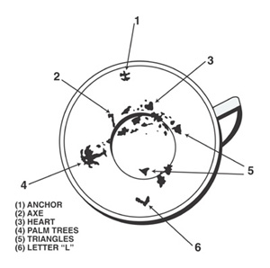

Sup Ct: What’s at Issue(s)?
L'Heureux-Dubé
What is the standard of review of administrative tribunals on questions of law arising out of a tribunal's interpretation of its own enabling legislation?
Did the Tribunal's interpretation of the term "family status" in s. 3 of the Act meet the proper standard of review?
Did the Tribunal's conclusion that art. 19.02 of the collective agreement entered into between the Treasury Board and CUPTE infringes s. 3 of the Act meet the proper standard of review?
[“I would formulate the issues in this case differently than the majority in order to more accurately reflect my view of the case.”]
La Forest
What is the standard of review of decisions of a human rights tribunal in the interpretation of its enabling legislation?
Did the Federal Court err in holding that the term family status did not include a homosexual relationship between two individuals?
Lamer
Did the Federal Court of Appeal err when it held that any error of law by a Canadian Human Rights Tribunal is reviewable on an application pursuant to s. 28 of the Federal Court Act?
Did the Federal Court of Appeal err when it held that the term "family status" in the CHRA did not include a homosexual relationship between two individuals?

Slide 11
Federal Court Act (then)
Federal Courts Act (now)
28. (1) … [T]he Court of Appeal has jurisdiction to hear and determine an application to review and set aside a decision or order, other than a decision or order of an administrative nature not required by law to be made on a judicial or quasi-judicial basis, made by or in the course of proceedings before a federal board, commission or other tribunal, on the ground that the board, commission or tribunal
. . . . .
(b) erred in law in making its decision or order, whether or not the error appears on the face of the record.
18.1 Powers of Federal Court
(3) On an application for judicial review, the Federal Court may…
(b) declare invalid or unlawful, or quash, set aside or set aside and refer back for determination in accordance with such directions as it considers to be appropriate, prohibit or restrain, a decision, order, act or proceeding of a federal board, commission or other tribunal.
(4) The Federal Court may grant relief under subsection (3) if it is satisfied that the federal board, commission or other tribunal
acted without jurisdiction, acted beyond its jurisdiction or refused to exercise its jurisdiction;
failed to observe a principle of natural justice, procedural fairness or other procedure that it was required by law to observe;
erred in law in making a decision or an order, whether or not the error appears on the face of the record;
based its decision or order on an erroneous finding of fact that it made in a perverse or capricious manner or without regard for the material before it;
acted, or failed to act, by reason of fraud or perjured evidence; or
acted in any other way that was contrary to law.

Slide 12
Lamer
Statutory interpretation 1: sec. 28 Federal Court Act
  Jurisdiction to review if “erred in law”
    Error in law in this case = statutory interpretation 2 (meaning of “family status”)
Question of law
  “reviewable”?
    No privative clause
    Not specialized tribunal (unlike labour board interpreting own act)
    Purely adjudicative (is? does?) not political (should?)
      Only statutory interpretation…
Wrong: statutory interpretation 2
  Legislative intent clear (no action on HR Commission’s recommendation to add sexual orientation…)
    No ambiguity, therefore no leeway (exc. for Charter consistency)

Slide 13

La Forest
The Standard
Deference re: questions of fact
  Patent unreasonableness
No deference re: questions of law
  Correctness
BUT Exceptions (e.g., labour board)
  Strong privative clause (cf. Consolidated Bathurst)
    Not here
  Expertise
    Not here
      Adjudicative
        Not even labour arbitrator (never mind board)
          Not self-selected (relevance?)
          “direct influence on society at large in relation to basic social values” (?)
      Expertise re: fact-finding and adjudication only

Slide 14

La Forest
The Standard Applied
“Family status”
  Statutory interpretation ABC (that’s what we, courts, do best!):
    In determining the intent of Parliament, one must, of course, give to the words used in a statute their usual and ordinary sense having regard to their context and to the purpose of the statute.
      Of course!
    “The dominant conception of family is the traditional family.” …
      Statutory language, extraneous evidence (re intent) clear
      Nothing to interpret: easy as pie
        How could Tribunal get so much so wrong?!
        Luckily, the courts are there to fulfill their “general supervisory role”!

Slide 15
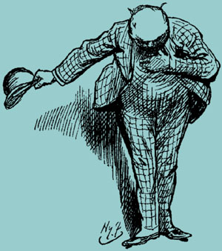
L'Heureux-Dubé (dissent)
Spectrum of deference
  Economically efficient, expeditious
    Police
  Fundamental justice (personal rights and freedoms)
    Law
“principle of deference”
  Exceptions
    Jurisdictional error
    Patently unreasonable error
      “fact or law”!
Considerations
  1. Breadth of delegated power
    the broader, the more deference
    Privative clause
      not determinative
  2. Expertise
  3. Nature of issue
    The more policy, the more deference
  Fact vs. law
Pragmatic and functional: “Did the legislator intend the question to be within the jurisdiction conferred on the tribunal?” Who is the best person for the job? (Willis…)
  Yes: patently unreasonable
  No: correctness

Slide 16
Canadian Human Rights Act
27. (1) In addition to its duties … with respect to complaints regarding discriminatory practices, the Commission …
(a) shall develop and conduct information programs to foster public understanding of this Act and of the role and activities of the Commission thereunder …;
(b) shall undertake or sponsor research programs relating to its duties and functions under this Act …;
(c) shall maintain close liaison with similar bodies or authorities in the provinces in order to foster common policies and practices and to avoid conflicts respecting the handling of complaints in cases of overlapping jurisdiction; …
(e) may consider such recommendations, suggestions and requests concerning human rights and freedoms as it receives from any source …;
(f) shall carry out or cause to be carried out such studies concerning human rights and freedoms as may be referred to it by the Minister of Justice …;
(g) may review any regulations, rules, orders, by-laws and other instruments made pursuant to an Act of Parliament …; and
(h) shall … endeavour by persuasion, publicity or any other means that it considers appropriate to discourage and reduce discriminatory practices ….

Slide 17
Three Factors
(pragmatic and functional)
patently unreasonable
  1. Statute
    Human Rights Act
      Broad powers
      No privative clause (nor the opposite (enabling?)…)
  2. Board
    “highly specialized admin body”: sensitivity, understanding, and expertise (Baker?)
      Experience; commission complaint (see arguments in Mossop)
  3. Problem
    “context-specific setting”
  Exhaustive list? No…

Slide 18
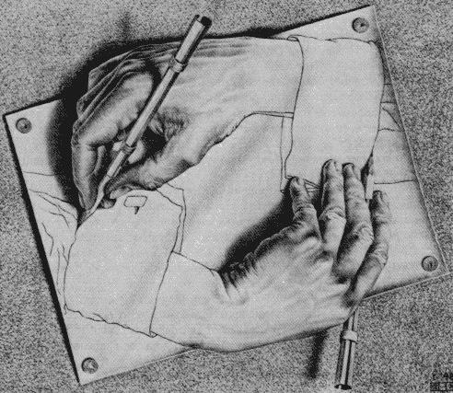
Patent unreasonability
What difference does it make?
  Would L'Heureux-Dubé have reached a different result
    under a different standard of review (correctness, say)? [see Cory and McLachlin dissents!]
    under the same standard, or any standard, if the Tribunal had ruled the other way?
  Would La Forest have reached a different result under the patent unreasonableness standard?
  Choice of standard is everything/nothing…
“family status”
  Approach to statutory interpretation
    “ordinary? (plain meaning)
      No: strict/legalistic/mechanical/textual traditional approach(e.g. expressio unius) inappropriate for interpretation to (quasi-)constitutional documents (HR Act)
    Instead: broad & purposive approach
    Choice of “approach” to statutory interpretation everything/nothing
  Applied
    Many conceptions of family, traditional, and non-…
      “Law and Family have long been engaged in an Escherian dialectic, each shaping the other while at the same time being shaped…”
    Family functions: Stability, nurturing…
    Family markers (not exhaustive, or determinative): existence of a relationship of some standing in terms of time and with the expectation of continuance, self-identification as a family, holding out to the public of the unit as a family, an emotional positive involvement, sexual union, raising and nurturing of children, caregiving to children or adults, shared housework, internal division of life-maintenance tasks, co-residence, joint ownership or joint use of property or goods, joint bank accounts, naming of other party as beneficiary of a life insurance policy…

Slide 19


Whatever happened to:
Willis, “Statute Interpretation in a Nutshell”?
(3) Subject Matter (Context²)
(2) Context
(1) Ordinary Meaning

Slide 20
Canadian Human Rights Act
2. The purpose of this Act is to extend the laws in Canada to give effect, within the purview of matters coming within the legislative authority of Parliament, to the principle that every individual should have an equal opportunity with other individuals to make for himself or herself the life that he or she is able and wishes to have, consistent with his or her duties and obligations as a member of society, without being hindered in or prevented from doing so by discriminatory practices based on race, national or ethnic origin, colour, religion, age, sex, marital status, family status, disability or conviction for an offence for which a pardon has been granted.
3. (1) For all purposes of this Act, race, national or ethnic origin, colour, religion, age, sex, marital status, family status, disability and conviction for which a pardon has been granted are prohibited grounds of discrimination.
7. It is a discriminatory practice, directly or indirectly, …
(b) in the course of employment, to differentiate adversely in relation to an employee, on a prohibited ground of discrimination.
9. (1) It is a discriminatory practice for an employee organization on a prohibited ground of discrimination
(c) to limit, segregate, classify or otherwise act in relation to an individual in a way that would deprive the individual of employment opportunities, or limit employment opportunities or otherwise adversely affect the status of the individual, where the individual is a member of the organization or where any of the obligations of the organization pursuant to a collective agreement relate to the individual.
10. It is a discriminatory practice for an employer, employee organization or organization of employers
(b) to enter into an agreement affecting recruitment, referral, hiring, promotion, training, apprenticeship, transfer or any other matter relating to employment or prospective employment,
that deprives or tends to deprive an individual or class of individuals of any employment opportunities on a prohibited ground of discrimination.
Collective Agreement
2.01 For the purpose of this Agreement,
(s) a "common-law spouse" relationship is said to exist when, for a continuous period of at least one year, an employee has lived with a person of the opposite sex, publicly represented that person to be his/her spouse, and lives and intends to continue to live with that person as if that person were his/her spouse.
19.02 For the purpose of this clause, immediate family is defined as father, mother, brother, sister, spouse (including common-law spouse resident with the employee), child (including child of common-law spouse), or ward of the employee, father-in-law, mother-in-law, and in addition a relative who permanently resides in the employee's household or with whom the employee permanently resides.
(a) Where a member of his immediate family dies, an employee shall be granted bereavement leave for a period of up to four (4) consecutive days and not extending beyond the day following the funeral. During such period he shall be granted special leave with pay for those days which would have been regularly scheduled working days. In addition, he may be granted up to three (3) days' special leave with pay for the purpose of travel to and from the place of the funeral.

Slide 21

Warm Up:
Some Thrusts and Parries, courtesy of Karl Löwelein
12. If language is plain and unambiguous it must be given effect.
15. Words are to be taken in their ordinary meaning unless they are technical terms or words of art.
20. Expression of one thing excludes another. [aka expressio unius…]
21. General terms are to receive a general construction.
22. It is a general rule of construction that where general words follow an enumeration they are to be held as applying only to persons and things of the same general kind or class specifically mentioned (ejusdem generis ).
27. A proviso qualifies the provision immediately preceding.
12. Not when literal interpretation would lead to absurd or mischievous consequences or thwart manifest purpose.
15. Popular words may bear a technical meaning and technical words may have a popular signification and they should be so construed as to agree with evident intention or to make the statute operative.
20. The language may fairly comprehend many different cases where some only are expressly mentioned by way of example.
21. They may be limited by specific terms with which they are associated or by the scope and purpose of the statute. [aka noscitur a sociis]
22. General words must operate on something. Further, ejusdem generis is only an aid in getting the meaning and does not warrant confining the operations of a statute within narrower limits than were intended.
27. It may clearly be intended to have a wider scope.

Slide 22

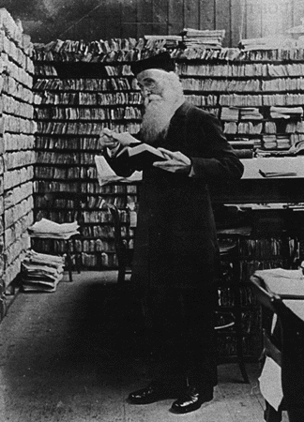
Back to Willis: (1) Ordinary Meaning
”What is the meaning of this word when read alone?”
  Dictionaries!
    Statutory dictionaries
    Law dictionaries
    General dictionaries
    French/English
Craig,
Daniel Craig.
How do you do, I’m an English dictionary!
Enchanté, je suis un dictionnaire français!
Hi, remember me?
I’m James Murray, Father of the OED.

Slide 23
More Willis: (2) Context
”What is the meaning of this word when read together with the rest of the words of the Act?”
  “Words, like people, take their colour from their surroundings.” [quoted in Bell ExpressVu!]
  (a) “Noscitur a sociis” [known by his/her associates]
      a general word takes its colour from the preceding specific words with which it is used [in “stab, cut or wound,” “wound” does not include biting off nose…]
  (b) “Ejusdem generis” [of the same kind]
      a general phrase, such as "or other causes", or "and all kinds of merchandise", takes its colour from the preceding specific words or phrases, and really means "or other causes of the same sort", or "and all kinds of merchandise of the same sort”
  (c) “Expressio unius [est] exclusio alterius” [the expression of one [is] the exclusion of another]
      a general word or phrase takes its colour as well from the specific words or phrases which follow it as from those which precede it [Nicholson…]
Today there is only one principle or approach, namely, the words of an Act are to be read in their entire context and in their grammatical and ordinary sense harmoniously with the scheme of the Act, the object of the Act, and the intention of Parliament. Bell ExpressVu Limited Partnership v. Rex, [2002] 2 S.C.R. 559 (quoting Driedger, Construction of Statutes 87 (2nd ed. 1983))

Slide 24
Still More Willis: (3) Subject matter
”What is the meaning of this word when read against the background of that part of human conduct with which the Act is dealing?”
Bell ExpressVu Limited Partnership v. Rex, [2002] 2 S.C.R. 559
  Where the provision under consideration is found in an Act that is itself a component of a larger statutory scheme, the surroundings that colour the words and the scheme of the Act are more expansive. In such an instance, the application of Driedger's principle gives rise to … "the principle of interpretation that presumes a harmony, coherence, and consistency between statutes dealing with the same subject matter".

Slide 25
From Willis to L’Heureux-Dubé:
The Big Melting Pot
Willis’s Nutshell’s Nutshell, Maxim of Maxims
  A court invokes whichever of the rules produces a result that satisfies its sense of justice in the case before it.
L’Heureux-Dubé’s LP version
  According to th[e] “modern approach”, consideration must be given at the outset not only to the words themselves but also, inter alia, to the context, the statute's other provisions, provisions of other statutes in pari materia and the legislative history in order to correctly identify the legislature's objective. It is only after reading the provisions with all these elements in mind that a definition will be decided on. This “modern” interpretation method has the advantage of bringing out the underlying premises and thus preventing them from going unnoticed, as they would with the “plain meaning” method.

