Slide 1
Administrative Law
Markus Dubber

Slide 2
Canadian Union of Public Employees Local 963 v. NB Liquor Corp. ‘79
(Nicholson ’79’s classmate)
New Brunswick Public Service Labour Relations Act (AGAIN/STILL!)
1 [“Employee” does not include (g) a person employed in a managerial or confidential capacity, nor (a) Order in Council appointments, (d) part-time employees, and (e) casual or temporary employees employed for less than six month)]
6(1) Nothing in this Act affects the right of the employer to determine the organization of the Public Service and to assign duties to and classify positions therein.
6(2) Subject to paragraph 102(3)(a), nothing in this Act affects the right of the employer to engage private contractors or contract work out for any purpose whatsoever.
101(1) [E]very order, award, direction, decision, declaration, or ruling of the Board, the Arbitration Tribunal or an adjudicator is final and shall not be questioned or reviewed in any court.
101(2) No order shall be made or process entered, and no proceedings shall be taken in any court, whether by way of injunction, certiorari, prohibition, quo warranto, or otherwise, to question, review, prohibit or restrain the Board, the Arbitration Tribunal or an adjudicator in any of its or his proceedings.
102(3) … [E]mployees may strike and during the continuance of the strike
the employer shall not replace the striking employees or fill their position with any other employee, and
(b) no employee shall picket, parade or in any manner demonstrate in or near any place of business of the employer.

Slide 3

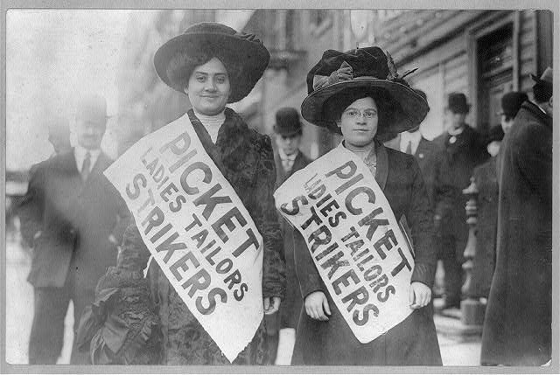
CUPE 1: The Board
Bitter labour dispute; no trust (or harmony); Board to the rescue to save/restore Industrial Peace, quickly (hearing Sept 8/19, decision Sept 20)!
Employer complaint: picketing contra 102(3)(b)
Union complaint: using management contra 102(3)(a)

Slide 4
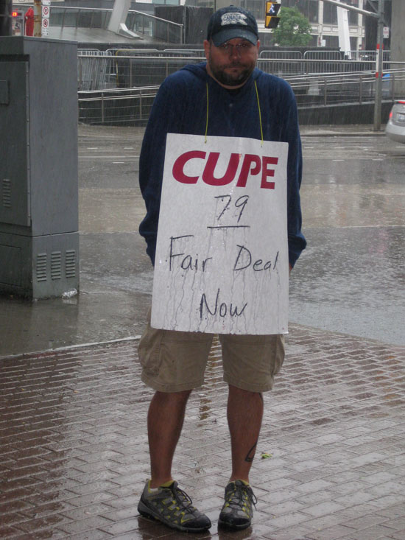
Employer complaint
Easy: yes
  “information picket”
  “in or near any place of business of the employer”
    1500ft, but designed to block traffic, therefore “near” enough

Slide 5
Union complaint
Not so easy: but also yes
102(3)(a): the employer shall not replace the striking employees or fill their position with any other employee
  Emp: “not (replace employees or fill their position) with any other employee”
  Union: “not (replace employees) or (fill their position with any other employee)
Side issue (context…):
  6(1) Nothing in this Act affects the right of the employer to determine the organization of the Public Service and to assign duties to and classify positions therein.
  6(2) Subject to paragraph 102(3)(a), nothing in this Act affects the right of the employer to engage private contractors or contract work out for any purpose whatsoever.
    Emp: no reference to 102(3)(a) in 6(1): permits “assignment” of management, but not contracting out (see 6(2))
    Union (and Board): 6(1) refers to “the sort of head office activity that lays out organizational tables, job descriptions and matters of that sort”
      Noscitur a sociis !!!!! (Willis: Words“Words, like people, take their colour from their surroundings.”)

Slide 6
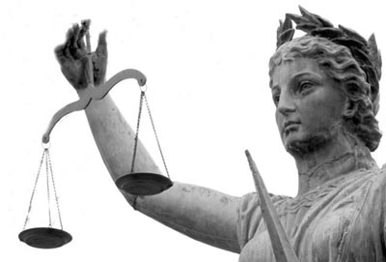
More stat int! hooray!
Prima facie, plain meaning, not enough—ambiguity!
  intention, intention, intention
  Balance, balance, balance in the public sector
    The legislature giveth and it taketh away, or rather taketh and taketh, from both sides
      No picketing = no replacement
        Replacing with any non-”employee”, incl. temps, part-timers

Slide 7

CUPE 2: NB COA
Limerick
  Side issue: 6(1)
    Board “did not err”
  Main issue: 102(3)
    Union argument: intra vires
      Court not authorized to review interpretation of 102(3)
    Court: jurisdiction is preliminary question
      Intra or ultra vires?
        Interpretation of 102(3) determines jurisdiction
          Bootstrap: wrong interpretation of act generates jurisdiction
        Jurisdiction extends not to interpretation of act, but only to its application
      Correctness (of interpretation)

Slide 8
Stat int, take 2
102(3)(a): “the employer shall not replace the striking employees or fill their position with any other employee”
  Board correct: “the employer shall not replace the striking employees,” period (in other words, “any other employee” only qualifies “fill their position,” not the first clause, “replace”)
    But different rationale/rule of stat int: not noscitur a sociis, but “meaning should be given to all words used in a statute if a reasonable interpretation would result”
      6(2) Subject to paragraph 102(3)(a), nothing in this Act affects the right of the employer to engage private contractors or contract work out for any purpose whatsoever.
        If “shall not replace” referred only to replacement with “other employees,” and contract workers are not “employees,” then 102(3)(a) would not apply to contract workers; if so, then 6(2)’s reference to 102(3)(a) would be “meaningless and surplusage”

Slide 9

Stat int, take 2 cont’d
102(3)(a) (simplified): “the employer
shall not replace the striking employees”
  “replace” [vs. fill the position]
    Permanent vs. temporary
    OED!!:
      To take the place of another; to fill the place of another
    Ergo: replace = permanent [fill the position = temporary]
      Replace “intends to infer some degree of fixed length of employment or contract of service, a concept antagonistic to the interpretation that the word ‘replace’ is intended to mean the temporary replacement or performing the function of the striking employee during the indefinite period of the strike. If ‘replace’ is to be deemed to mean have some other person do his work temporarily, such a meaning would render ‘fill their position’ redundant and surplusage.” [same rule, again…]
Applied: no problem with temporarily using management to do strikers’ job
  Since that wouldn’t amount to (permanently) “replacing” them

Slide 10
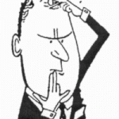
Concurrers
Hughes, CJ
  Same result, same rule of stat int (everything has meaning…)
  BUT: different interpretation (different meaning…)
    Replace = temporary
    Fill the position = permanent
    “with any other employees” qualifies both clauses!!
      Under this reading, employer could “replace” employees with anyone not defined as “employee” (incl. part-timers, temps)
        Mischief? “Such may be a defect in the wording of the clause”
Bugold
  Umm, I agree with both …

Slide 11
SCC, Dickson J.
Side issue (s. 6(1)): Board = COA = SCC!; next The Big Show: 102(3)
But first, a preliminary matter [false/bad/pretended jurisdiction…]:
  Limerick’s “preliminary or collateral matter”
With respect, I do not think that the language of "preliminary or collateral matter" assists in the inquiry into the Board's jurisdiction. One can, I suppose, in most circumstances subdivide the matter before an administrative tribunal into a series of tasks or questions and, without too much difficulty, characterize one of those questions as a "preliminary or collateral matter". [Q]uestions of fact will naturally be regarded as "the primary and central questions for decision", whereas the "prescribed statutory ingredients will be more readily found to be collateral". This is precisely what has occurred in this case, the existence of the prohibition described in the statute becoming the "collateral matter", and the facts possibly constituting breach of the prohibition, however interpreted, the "primary matter for enquiry". Underlying this sort of language is, however, another and, in my opinion, a preferable approach to jurisdictional problems, namely, that jurisdiction is typically to be determined at the outset of the inquiry.
The question of what is and is not jurisdictional is often very difficult to determine. The courts, in my view, should not be alert to brand as jurisdictional, and therefore subject to broader curial review, that which may be doubtfully so.

Slide 12
Dickson cont’d
“True” jurisdiction: no problem
The parties before the Board, a separate employer identified in the Act, and a bargaining agent duly certified under the Act, were certainly those entitled to initiate the inquiry according to s. 19(1), and to be parties to that inquiry. The general subject-matter of the dispute between the parties unquestionably fell within the confines of the Act, that is, the situation of a strike by employees which is considered lawful by the very provisions of the Act. The Board was asked by the parties to determine whether certain activities of the Union and of the employer during that lawful strike were in violation of a prohibition in the Act, i.e. s. 102(3). The Union took no jurisdictional objection to the ban on picketing contrary to s. 102(3)(b), nor did the employer. The employer, in its reply to the Union complaint of violation of s. 102(3)(a), only contended that the Liquor Corporation "has not in any way violated" that provision. One cannot therefore suggest that the Board did not have "jurisdiction in the narrow sense of authority to enter upon an inquiry.”

Slide 13

(More) reasons for restraint
Privative clause
Specialized tribunal with broad delegated powers
  “called upon” to adjudicate (findings of fact and law) and “to exercise its understanding of the body of jurisprudence that has developed around the collective bargaining system, as understood in Canada, and its labour relations sense [Llewellyn?] acquired from accumulated experience in the area.
  Super-broad powers: importance of maintaining public services (sensitivity, expertise…); s. 102(3) unique
Question: Interpretation of home statute
  “at heart of the specialized jurisdiction confided to the Board”; “[N]ot only would the Board not be required to be ‘correct’ in its interpretation, but one would think that the Board was entitled to err and any such error would be protected from review by the privative clause”

Slide 14
Patent unreasonableness!?
In my view, that would be sufficient to dispose of this appeal. [!!] The Court of Appeal wrongly was of the opinion that the existence of the prohibition was a preliminary matter and, therefore, the Board's decision was subject to review for its "correctness." I would take the position that the Board decided a matter which was plainly confided to it, for it alone to decide within its jurisdiction.
[Coda, dictum, musings…] It is contended, however, that the interpretation placed upon s. 102(3)(a) was so patently unreasonable that the Board, although possessing "jurisdiction in the narrow sense of authority to enter upon an inquiry", in the course of that inquiry did "something which takes the exercise of its powers outside the protection of the privative or preclusive clause".
  Was the Board's interpretation so patently unreasonable that its construction cannot be rationally supported by the relevant legislation and demands intervention by the court upon review?
    Early guess: no…

Slide 15
3 (or 4) Reasonablenesses
Reasonableness 1: Board
Reasonableness 2: Limerick
Reasonableness 3: Hughes
(Reasonableness 4: Bugold (both 2 and 3, or either one))
“There is no one interpretation which can be said to be ‘right.’”
  Llewellyn? Willis? Or only in this case?
“Upon a careful reading of the Act, the Board's decision, and the judgments in the Court of Appeal, however, I find it difficult to brand as "patently unreasonable" the interpretation given to s. 102(3)(a) by the Board in this case. At a minimum, the Board's interpretation would seem at least as reasonable as the alternative interpretations suggested in the Court of Appeal. Certainly the Board cannot be said to have so misinterpreted the provision in question as to ‘embark on an inquiry or answer a question not remitted to it.’”

Slide 16

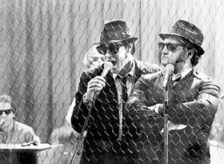
CUPE Round-Up (Dickson, J.)
One can, I suppose, in most circumstances subdivide the matter before an administrative tribunal into a series of tasks or questions and, without too much difficulty, characterize one of those questions as a "preliminary or collateral matter". [Q]uestions of fact will naturally be regarded as "the primary and central questions for decision", whereas the "prescribed statutory ingredients will be more readily found to be collateral". …
The question of what is and is not jurisdictional is often very difficult to determine. The courts, in my view, should not be alert to brand as jurisdictional, and therefore subject to broader curial review, that which may be doubtfully so.

Slide 17
Crevier v. Quèbec (Attorney General)
[1981] 2 S.C.R. 220 (Laskin, C.J.)
_{BNA (Constitution Act) 1867}
96. The Governor General shall appoint the Judges of the Superior, District, and County Courts _{in} each Province, except those of the Courts of Probate in Nova Scotia and New Brunswick.
Professional Code, R.S.Q. 1977, c. C-26
194. No extraordinary recourse contemplated in articles 834 to 850 of the Code of Civil Procedure shall be exercised and no injunction granted against the persons mentioned in section 193 acting in their official capacities.
_{Quebec Code of Civil Procedure}
846. The Superior Court may, at the demand of one of the parties, evoke before judgment a case pending before a court subject to its superintending and reforming power, or revise a judgment already rendered by such court, in the following cases:
1. when there is want or excess of jurisdiction;
2. when the enactment upon which the proceedings have been based or the judgment rendered is null or _{of no effect;}
3. when the proceedings are affected by some gross irregularity, and there is reason to believe that justice has not been, or will not be done;
4. when there has been a violation of the law or an abuse of authority amounting to fraud and of such a nature as to cause a flagrant injustice.

Slide 18
Laskin’s Limits
[W]here a provincial Legislature purports to insulate one of its statutory tribunals from any curial review of its adjudicative functions, the insulation encompassing jurisdiction, such provincial legislation must be struck down as unconstitutional by reason of having the effect of constituting the tribunal a s. 96 court.
It is true that this is the first time that this Court has declared unequivocally that a provincially-constituted statutory tribunal cannot constitutionally be immunized from review of decisions on questions of jurisdiction. * * * There may be differences of opinion as to what are questions of jurisdiction but, in my lexicon, they rise above and are different from errors of law, whether involving statutory construction or evidentiary matters or other matters. It is now unquestioned that privative clauses may, when properly framed, effectively oust judicial review on questions of law and, indeed, on other issues not touching jurisdiction. However, … s. 96 is in the British North America Act and … it would make a mockery of it to treat it in non-functional formal terms as a mere appointing power…

Slide 19
Let’s not get carried away; no bootstrapping allowed
There has been academic concern with the permitted scope of privative clauses referable to determinations of provincial adjudicative agencies. Opinion has varied from a position that even errors of law cannot validly be immunized from review, to a position that at least jurisdictional review is constitutionally guaranteed to a position that jurisdictional determinations may, constitutionally, also be denied judicial review.
This Court has hitherto been content to look at privative clauses in terms of proper construction and, no doubt, with a disposition to read them narrowly against the long history of judicial review on questions of law and questions of jurisdiction. Where, however, questions of law have been specifically covered in a privative enactment, this Court * * * has not hesitated to recognize this limitation on judicial review as serving the interests of an express legislative policy to protect decisions of adjudicative agencies from external correction. Thus, it has, in my opinion, balanced the competing interests of a provincial Legislature in its enactment of substantively valid legislation and of the courts as ultimate interpreters of the British North America Act and s. 96 thereof. The same considerations do not, however, apply to issues of jurisdiction which are not far removed from issues of constitutionality. It cannot be left to a provincial statutory tribunal, in the face of s. 96, to determine the limits of its own jurisdiction without appeal or review.

Slide 20
