Slide 1

Discrimination and Harassment:
What/where’s law….

Slide 2
Discrimination and Harassment:
The case of work
Many discrimination complaints arise at work
Multiple legal fora at which they might be litigated

Slide 3
Routes and remedies for discrimination and harassment:
Public law
Canadian Charter of Rights and Freedoms
  s.15 – equality provisions
    But see limits!
Human rights codes (provincial and federal)

Slide 4
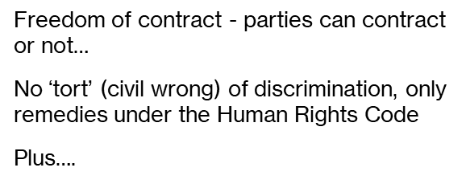
Discrimination and Harassment:
What does private law say?

Slide 5
At common law:
Employment is a contract of (legal) subordination
Employer has, at law, the authority to direct the conduct of work
Employee must
obey lawful orders
act in good faith
further the employer’s interests

Slide 6
At common law:
No right to a job
Employer can fire you for:
good reason,
bad reason or
no reason at all!
Only (legal) entitlement is notice, or pay in lieu

Slide 7
But…..
Constructive dismissal
Something the employer does, amounting to a repudiation of the contract, that justifies the employee treating the contract of employment as terminated!
  A single act, or
  A ‘course of conduct’
    Potter v. New Brunswick Legal Aid (SCC, 2015)

Slide 8
Scenarios: Ontario Court of Appeal
Shaw v. Xerox -recognizing
a course of harassing conduct ….
constitutes constructive dismissal
  Harassment:
        by employers
        by customers, others?
          possibly
Boucher v. Wal-Mart
deliberately abusive behaviour
A case of constructive dismissal, but also:
tort of intentional infliction of emotional harm
flagrant, public,
resulting in harm

Slide 9
What are terms ‘implied at law’?
Something that the parties didn’t bargain over.. but are ‘read in’ to the contract by the courts, such as:
New(ish) implied terms:
        A right to be treated with dignity and respect
        A right to good faith treatment in the manner of dismissal
        A general duty of good faith, including in the performance of a contract
        Mohamed v. Information System Architects

Slide 10
On the horizon…
Algorithmic wage (and other) discrimination

